Slide 1
DevOps and Open Source Tools – Unravelled
DevOps Index
July 2017
Mark Steffensen
ADM Technical Enablement

Slide 2
Categories
Source Code Management Tools
Code and Infrastructure Build Tools
CI/CD Tools
Integrated Development Environments
Behavior Driven Development (BDD) Tools
Test Management Tools
Mobile App Environments
Issue Tracking and Project Management
ChatOps Tools
Performance Engineering Tools
Security Tools
Agile Management Tools
Containerization
Monitoring
Code Metrics
Other Tools
The
Behavior Driven Development (BDD) Tools
Test Management Tools
Mobile App Environments
Issue Tracking and Project Management
ChatOps Tools
Performance Engineering Tools
Security Tools
Agile Management Tools

Slide 3
DevOps Index (1 of 3)
SCM: | CI/CD Tools: | IDE’s: | Test Management: | Mobility:
CVS | Codar | Eclipse | ALM/Octane | Mobile Center
Subversion (SVN) | Jenkins | Visual Studio | JUnit | Appium
Git/Github | CloudBees | IntelliJ IDEA | NUnit | Android Studio
BitBucket / Stash | TFS | WebStorm (JS) | TestNG | Experitest (SeeTest)
TFS | ElectricCloud | NetBeans | Selenium * | Genymotion
Perforce | Bamboo | Mylyn | Zephyr (for Jira) | Keynote (Dynatrace)
Seapine | TeamCity | Xcode (Mobile IDE) | Applitools | Containerization:
ClearCase | CruiseControl | BDD: | SmartBear | Docker
Mercurial | Go | Cucumber | BrowserStack | Kubernetes
Issue Tracking: | CA Release Auto | Gherkin | Sauce Labs | Apache Mesos
Jira | Snap | SpecFlow | Tosca (Tricentis) | Amazon ECS
BugZilla |  | JBehave/NBehave | Gauge | Google Cntnr Engine
YouTrack |  | Behat | FitNesse | Azure Cntnr Service
J
A
J
T
A
J
T
A
T
J
Atlassian
ThoughtWorks
JetBrains

Slide 4
DevOps Index (2 of 3)
Back to Index
Performance: | Agile: | Monitoring: | Languages | Virtualization:
StormRunner | Agile Manager | AppPulse | Python | Service Virt.
LoadRunner | ALM Octane | SiteScope | Ruby / on Rails | CA Lisa
SOASTA | CA Rally Dev | New Relic | GO | IBM Green Hat
Gatling | VersionOne | Loggly | CSharp (C#) | Parasoft Virtualize
BlazeMeter | Mingle | Sumo Logic | Java | Chat Ops:
JMeter | TeamForge | Dynatrace | JavaScript | Slack
Grinder | Code/Infra Build: | Service Now | Swift | HipChat
Security: | Make | Nagios | CoffeeScript | Other Tools/Tech:
WebInspect | Ant | Splunk | Node.js | Swagger
Fortify | Maven | Code Metrics: | Curl | Ansible
SecureAssist | Gradle | Cobertura | Scala | Hubot
Veracode | SaltStack | SonarQube | PHP | IFTTT
CyberArk | Chef / Puppet | JaCoCo | Perl | YAML Files
T
A
Atlassian
ThoughtWorks
JetBrains

Slide 5
DevOps Index (3 of 3)
Back to Index
Other Tools/Tech:
Kibana – Elastic | Bower | TypeScript | Gogland
Angular JS | Grunt | EggPlant-TestPlant | CloudSlang
Nexus | Mocha | Ngrok | Kotlin
Xebia Labs | Snort | Clarity
ElasticSearch | Protractor | Asana
Kafka | TaskTop | Postgres
NCover | CodeBeamer ALM | MySQL
Nginx | Heroku | SQLLite
JFrog Artifactory | Verigreen | Redis
UTest | Trello | Rabbit MQ
SkyTap | JuJu | Solar Winds
HatSize | Vagrant | Wercker |  | DevOpsToolChest
Worksoft | NCover | Glide |  | PeriodicTable
Atlassian
ThoughtWorks
JetBrains

Slide 6
Company Product or Tool Name
Back to Index
Company Logo
Corporate Tag Line
https://www.company_name.org
Notable feature, capability or quote – This is the text describing the feature.
Notable feature, capability or quote – This is the text describing the feature.
Notable feature, capability or quote – This is the text describing the feature.
Notable feature, capability or quote – This is the text describing the feature.
Notable feature, capability or quote – This is the text describing the feature.
Notable feature, capability or quote – This is the text describing the feature.
Screenshot
or
Graphic
Typical Slide Format

Slide 7
What is Open Source?
Back to Index

Slide 8
What is Open Source?
Back to Index
Closed Source (proprietary software)
Computer users must agree (usually by signing a license) that they will not do anything with the software that the software's authors have not expressly permitted.
Open Source
Refers to something that can be modified and shared because its design is publicly accessible.
Designates a set of values.
Is software whose source code is available for modification or enhancement by anyone.
Open source software licenses promote collaboration and sharing.
Open source software isn’t always free. Some companies add support options, customizations.
Why do developers gravitate to Open Source?
No need to reinvent the wheel
Generally tested and reliable
Cheap or free
More control over functionality
Cool factor – contributing to the collective

Slide 9
Pros and cons of Open Source
Back to Index
Pros
Few if any licensing fees – Everyone likes free!
Easy to manage – Install everywhere, no license monitoring.
Continuous improvement – Anyone can edit and improve it.
Company Independence – Code survives beyond corporate walls.
Open Kimono – You can see what’s inside.
Cons (open sores?)
It’s not free – Hidden ramp up and debugging time costs.
Learning curve – Often long times spent familiarizing with a solution.
Confused users – What version works with what? Bugs still exist.
Orphan software – Some open source projects die on the vine.
No real support – Community support is sketchy and not time bound.
Security not guaranteed – spyware, adware, compliance (ISO, SSO, when?) not a priority
Hundreds of options – Which to choose? How to evaluate?

Slide 10
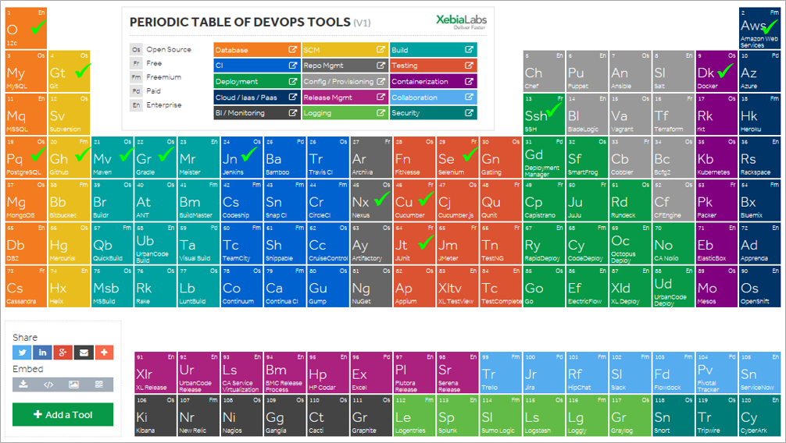
DevOps and Open Source
Back to Index
DevOps is chock full of Open Source tools
Organizations are looking for direction, answers
Tool sets are evolving quickly
Be a credible advisor

Slide 11
Open Source – Perspective (Antonio Neri)
Back to Index
About 70 different open source licenses and each has it’s own quirks and nuances
There are 2 major license types:
GPL (Gnu General Public License)
Apache License
GPL – (CopyLeft principle, e.g. Linux kernel)
if you change/enhance the source code of a GPL licensed project, you have to give back all those changes (reciprocity).
you are required by that license to supply the source code with it.
Apache (most new startup stuff e.g. Hadoop, Mesos, etc).
you can take the code, do what you want, and you don’t have to give your changes back if you don’t want to.
the public source code version can be 12 -18 months behind what the vendor is actually shipping.
Important Aspects
Brand Association - customers will associate a specific company with a specific open source project
Code check-in – BDFL (Benevolent Dictator For Life) – often only one company has check-in rights

Slide 12
Open Source – Perspective (Antonio Neri)
Back to Index
Companies simply want open source because they perceive it as lower cost, and protection from vendor lock-in (i.e. Oracle).
The reality is that even with open source, it’s highly unlikely they’d ever be able to support themselves and they are often just as locked in.
When done well, and with a properly thought out strategy, it can be a powerful arsenal in your toolset.
Done wrong and it can be a giant waste of time, energy and resources.
Summary
Open source is not ONE thing. It is a complex array things with many nuances to contend with
Pay attention to brand ownership/association
Pay attention to the license model chosen (Most prefer the GPL whenever possible)
Play close attention to who has check-in privileges
Look for the various tricks that companies (often startups) use to “fake” open source

Slide 13
What is Continuous Integration - Continuous Delivery and DevOps?
Back to Index

Slide 14
Continuous Integration - The Evolution
Back to Index
1991: Continuous Integration (CI) named and proposed by Grady Booch
2001: Agile Manifesto was written, its 1st principle says:
“Our highest priority is to satisfy the customer through early and continuous delivery of valuable software.“
2006: CI coined by Martin Fowler
2006 – 2010: CI evolved into Continuous Delivery (CD)
2009: The term DevOps was coined, and the first "DevOps Days" conference held
Now: DevOps
CI is commodity.
Integrated CD tools focus on deployment and pipeline management.
Continuous Assessment
Expanding integrations with cloud
Notes:
In fact, from Continuous Integration to Continuous Deployment and DevOps – it reflects the evolution of software engineering principles and practices.
The name of Continuous Integration –CI was proposed by Grady Booch in 1991. At the beginning, it was adopted as part of extreme programming (XP) - a type of agile development. You can see, these things are closely related to Agile since the start. CI is the disruption of Build Management, it addresses the integration challenges by automatically building and running the unit tests periodically or even after every commit and reporting the results to the developers.
Continuous Deployment is the natural extension of Continuous Integration by adding the regular deployments to production as part of the process. It emerged around the period from 2006 to 2010. It is an approach in which teams ensure that every change to the system
is releasable. So they can deliver frequently and get fast feedback on what users care about.
As agile methodology grew into common practice in the development space, people began to think about “Agile Systems Administration”, which led to the concept of DevOps. In 2009, the first “DevOps Days” conference was held, the term DevOps has been popularized since then.
Nowadays, many organizations have adopted Continuous Integration. Continuous Delivery with deployment and pipeline management are growing. And there came the Continuous feedback and Continuous Assessment that gather and evaluate feedbacks throughout the application lifecycle, in order to drive tactical decisions about quality and features.

Slide 15
What is Continuous Integration?
Back to Index
Continuous integration is a software development practice where members of a team integrate their work frequently, usually each
person integrates at least daily – leading to multiple integrations per
day. Each integration is verified by an automated build (including test)
to detect integration errors as quickly as possible.
Martin Fowler, May 2006
DevOps is really Continuous Everything!

Slide 16
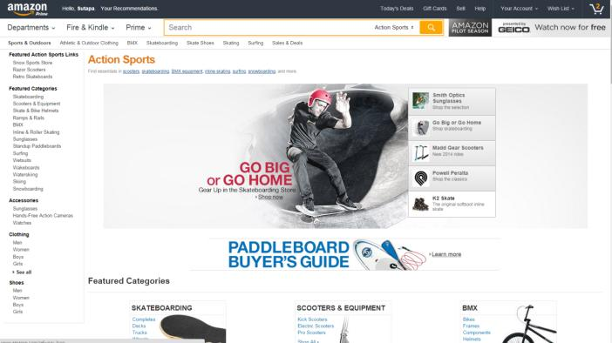
When DevOps works well…
Back to Index
Amazon.com
Code deployed every 11.6 seconds
Notes:
With DevOps, how fast it can be? Here’s an example. At Amazon.com, code is deployed every 11.6 seconds.
You will see how this may be achieved. The automation and traceability brought by DevOps is just amazing.

Slide 17
Continuous Integration / Continuous Delivery
Back to Index
The role of a CI/CD Server
Project Configuration
Artifact Repository
Source Code Management
Deployment Target
Checkout
Project workspace
Build
Test
Package
Deploy
/Publish
Deploy
Commit
Reporting and Notifications
CI/CD
Server
Developer’s workspace
Notes:
You need an engine to let the cycle run. Such software playing the engine role is called CI server – it is not called a CD server, maybe because they started back in the days when there was only CI. Now, many of these tools have evolved into something beyond CI – they handle the deployment, pipeline management and more. Jenkins is one product of this category.
This is a simpified view of what a CI server does. It can check out the code from the Source Repository, and build the executable. Then it runs the unit tests, and if everything’s fine it packages the software and deploys it to the target system for further testing or release to production. This flow matches what we saw in the previous slide, that the whole process is automated, and the success of one task will trigger the next one. At each step, it can give people reports and notifications, so you can drill down to the details if something goes wrong, or to use the report to communicate to stakeholders.
You can see that the CI server works together with some other tools to make the cycle run. On the left side, Developers use development tools to do programming and debugging. Then they check in their code into a Source Control Management tool. The code is then built into executables by Build tools. Then the executables are tested using Test tools. When they are tested OK, they get deployed using Deployment tools.

Slide 18
Typical Product Mappings
Back to Index
Project Configuration
Artifact Repository
Git, Github
Deployment Target
Checkout
Project workspace
Ant, Maven, MS Build
Xunit, LeanFT, JMeter
Package
Chef, Puppet, CODAR
Deploy
Commit
Reporting and Notifications
Jenkins / Bamboo
VS, Eclipse, IntelliJ
Notes:
You need an engine to let the cycle run. Such software playing the engine role is called CI server – it is not called a CD server, maybe because they started back in the days when there was only CI. Now, many of these tools have evolved into something beyond CI – they handle the deployment, pipeline management and more. Jenkins is one product of this category.
This is a simplified view of what a CI server does. It can check out the code from the Source Repository, and build the executable. Then it runs the unit tests, and if everything’s fine it packages the software and deploys it to the target system for further testing or release to production. This flow matches what we saw in the previous slide, that the whole process is automated, and the success of one task will trigger the next one. At each step, it can give people reports and notifications, so you can drill down to the details if something goes wrong, or to use the report to communicate to stakeholders.
You can see that the CI server works together with some other tools to make the cycle run. On the left side, Developers use development tools to do programming and debugging. Then they check in their code into a Source Control Management tool. The code is then built into executables by Build tools. Then the executables are tested using Test tools. When they are tested OK, they get deployed using Deployment tools.

Slide 19
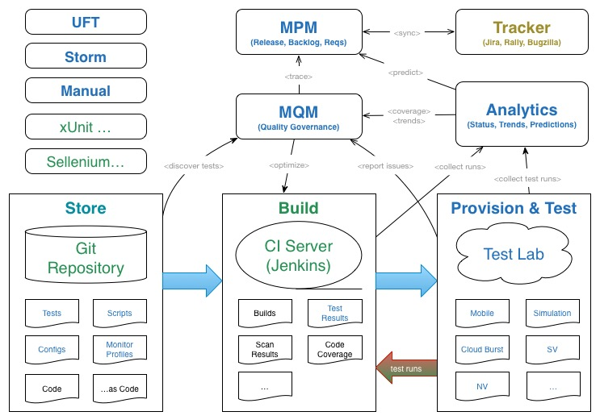
AGM/ALM Octane
Back to Index
NGA (Quality Governance)
Selenium
Notes:
At last, I want to mention the HP next-generation ALM. It is going to be HP’s new management tool aiming to meet the DevOps need. It is not available yet, and it may take several years to fully implement the features we envisioned, but there’s a conceptual picture. I want to show it here because it further emphasizes the importance of understanding tools such as Git and Jenkins.
Source code, tests, and maybe infrastructure code will be stored in an SCM repository, and Jenkins will be the engine to let the automation cycle run, and it passes artifacts to the Provision & Test part.
HP Next generation ALM will be able to oversee and manage the relationship of these things. I think HP has a nice vision here, because only these tools alone won’t provide the end-to-end visibility and traceability in DevOps.

Slide 20
Source Code Management Tools (SCM)
Back to Index

Slide 21
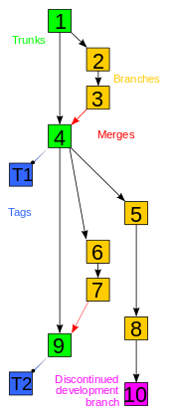
SCM Tools
Back to Index
Source Control Management
Source control is also known as Revision Control, Version Control
Different tools, same overall concept
Manage changes to documents and files
Organize collections of files into versions
Have a mechanism to coordinate simultaneous edits towards the same file
Concept of a commit (changes made visible to all)
Ability to rollback changes to a point-in-time
Allow people to develop two versions of the software concurrently
Common Tools
Git/Github
SVN (Subversion)
TFS (Team Foundation Server)
CVS (Concurrent Versions System)
Perforce
Comparison guide: HERE

Slide 22

Concurrent Versions System (CVS)
Back to Index
First to deal with files en masse
History
Characteristics
http://www.nongnu.org/cvs/
Created in 1986 – no new releases since 2008 (matured)
Developed from an earlier versioning system called RCS
Introduced capability of dealing with RCS files of an entire project
Successors include CVSNT, Subversion and numerous distributed version control systems.
Open-source, free software
Client/Server based, centralized version control
Design decisions made at a time when the development landscape was different from now
Does not support many of the modern features, e.g.:
Does not version the renaming of files
Commits are not atomic
Branch operations are expensive
Notes:
The first to mention is CVS – Concurrent Version System, an open-source, free software. It was created in 1986, the earliest among the tools we’re going to talk about. It introduced the capability of dealing with files of an entire project, instead of individual files.
It had been very popular for some years. But the software development world is changing, it began to require some features that CVS does not support, for example versioning of renamed files, atomic commit. Another issue is, branch operations are expensive in CVS.
So this product became matured and had no new release since 2008.
However CVS has many successors, those current popular products such as Subversion, Git are all considered the successors of CVS.

Slide 23


Subversion (SVN)
Back to Index
Most Compatible Successor of CVS
History
Characteristics
Open-source, free software
Centralized version control
Modern features supported:
Atomic commits
Renamed files retain revision
history
Versioning of symbolic links
Branching is a cheap operation
Merge tracking
International support
https://subversion.apache.org/
Originally created by CollabNet Inc. in 2000
A 2007 report by Forrester Research recognized SVN as the sole leader in the Standalone SCM category
Now a top-level Apache project, known as Apache Subversion
A successor of CVS which supplied some features missing in CVS
Many flavors of SVN made by vendors
Notes:
Let’s look at Subversion.
It was originally created by CollabNet Inc., and grew very popular after it became an open-source Apache project. It is one of the top SCM tools now.
Subversion was created with the objective of “being the most compatible successor of CVS”. Meanwhile it supplied those modern features missing in CVS. Atomic commit, Versioning of renamed files and symbolic links are all supported. Branching has become a cheap operation too.
We talked about the centralized and distributed repository model. Subversion uses the centralized model.

Slide 24

Git
Back to Index
A distributed SCM system
History
Characteristics
https://git-scm.com/
Initially developed by Linus Torvalds for Linux kernel development in 2005
Git is British English slang meaning "unpleasant person“
Has grown very popular since then
Distributed
Platform agnostic
Local full-fledged repository (not client-server)
Fast branching and merging
Scalable and high performance
Very strong safeguards against corruption
Notes:
We talked about why there came the distributed repository model. Git is not the first distributed SCM tool, but can be said the most popular one in this category.
Git was created by a famous person - Linus Torvalds, for his Linux kernel development work. He was using a good tool called BitKeeper, but one day he could no longer use it for free, so he decided to write his own. As a result, of course Git is open-source and free.
Git is strong in several aspects:
No. 1 ( Support Distributed development workflow)
Git gives each developer a local copy of the entire development history – this is very efficient in distrusted development. Changes are copied from one such repository to another. These changes are imported as additional development branches, and can be merged in the same way as a locally developed branch.
No. 2 ( Strong Support for non-linear development )
Git supports rapid branching and merging, and includes specific tools for visualizing and navigating a non-linear development history. A core assumption in Git is that a change will be merged more often than it is written, as it is passed around various reviewers. Branches in Git are very lightweight: A branch in Git is only a reference to a single commit. With its parental commits, the full branch structure can be constructed.
No. 3 ( Efficient handling of large projects )
Torvalds has described Git as being very fast and scalable, and performance tests done by Mozilla showed it was an order of magnitude faster than some version-control systems, and fetching version history from a locally stored repository can be significantly faster than fetching it from the remote server.
No. 4 ( Strong safeguard against corruption)
In Git, for data integrity, file contents, index and file names all contain a SHA-1 checksum, so that data inconsistency can be easily detected.
(both packfile and its index have SHA-1 checksum inside, and also the file name of packfile contains a SHA-1 checksum. )

Slide 25

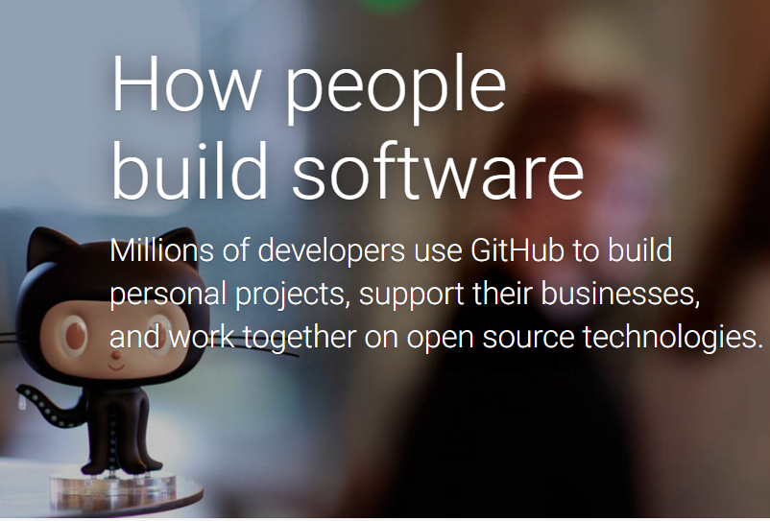
GitHub
Back to Index
Largest host of source code in the world
A web-based Git repository hosting service
https://github.com/
Over 12 million users and over 31 million repositories
Offers all of the SCM functionality of Git
Web-based graphical user interface
Offers both private repositories and free accounts
Features:
Access Control
Bug Tracking
Feature Requests
Task Management
Wikis

Slide 26

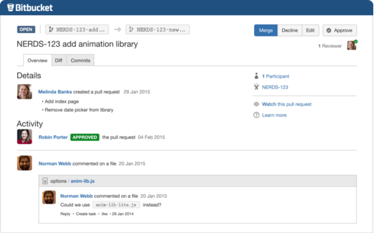
BitBucket / Stash Server
Back to Index
Git your way
https://www.atlassian.com/software/bitbucket/server
Code collaboration on steroids – Stop, collaborate and listen. Get your team talking early and often in your source code with inline comments and mentions.
Review Code – Code review enhances code quality. Learn best practices and review code efficiently in Bitbucket with pull requests.
Flexible deployments – In the cloud or self-hosted, the choice is yours. Bitbucket's infrastructure flexibility provides full control over how it fits in your environment.
Permissions that matter – Granular user management options ensure only the right people have the right access to your code, all the way down to the branch level.
Atlassian

Slide 27

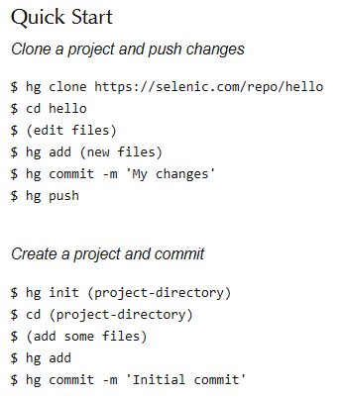
Mercurial
Back to Index
Work Easier, Work Faster
https://www.mercurial-scm.org/
Mercurial is a cross-platform, distributed revision control tool for software developers. It is mainly implemented using the Python programming language, but includes a binary diff implementation written in C. It is supported on MS Windows and Unix-like systems, such as FreeBSD, Mac OS X and Linux.
Mercurial is a free, distributed source control management tool. It efficiently handles projects of any size and offers an easy and intuitive interface.
It is fast and powerful – Mercurial efficiently handles projects of any size and kind. Every clone contains the whole project history, so most actions are local, fast and convenient. Mercurial supports a multitude of workflows and you can easily enhance its functionality with extensions.

Slide 28
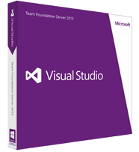
TFS
Back to Index
Visual Studio – Team Foundation Server
History
Characteristics
https://www.visualstudio.com/en-us/products/tfs-overview-vs.aspx
Before 2004 Microsoft had Visual Studio that was only a developer tool
Nov. 2004 Microsoft release their first version of an integrated ALM solution – Visual Studio 2005 Team System
The version control engine TFVC was written from scratch in the above release
Apr. 2010 Visual Studio Team Explorer Everywhere (TEE) 2010 announced, with cross-platform capability (Eclipse and Java)
Adopted Git as the core source control tool since TFS 2013
TFS is central component of Microsoft ALM suite under the Visual Studio brand
SCM is only part of the TFS functionalities
Available in two forms, on-premise and online
API: Can communicate with any tool that can call a web service
Data can be aggregated into the warehouse database for complex trend reporting and data analysis
Good integration with MS Office suite and Sharepoint
Notes:
Microsoft TFS is a tool combining features of application lifecycle management, source control, build, etc. The Source Control engine of TFS is called TFVC, which is different from Microsoft Visual Source Safe. TFVC was created from scratch in the first release of TFS, and had been the core engine for some years. In TFS 2013, Microsoft started to use Git as the core source control engine, though TFVC is still there.
Microsoft source control solution embraces the modern requirements, so it is offered in two forms – online and on-premise. It has a very good API and can be integrated with data analysis tools and Microsoft Office suite.

Slide 29

Perforce (P4)
Back to Index
Proprietary Pre-Configured SCM
History
Characteristics
https://www.perforce.com/
Perforce (centralized SCM) was the first product developed by Perforce Software, Inc. founded in 1995
Many releases since then
Mar. 2015, Perforce Software released Perforce Helix expanding Perforce's range (including distributed version control capability)
Performs well on large repositories
Good visualizations of branching and merging
Though centralized SCM, supports distributed teams by remote depots and replication
Can make part or all of its content available as Git repositories
Free license available for small-scale usage
Adopted by many organizations worldwide, including Google
Notes:
Perforce –also called p4- is a proprietary SCM tool started from 1995. It is liked by some enterprise customers including Google, because it performs well on very large repositories and has good visualizations of branching and merging.
For many years Perforce has been using the centralized repository model, but in March this year, Perforce Helix has been released that expands the traditional range of perforce. Distributed version control is one of the capabilities introduced in this new release.

Slide 30

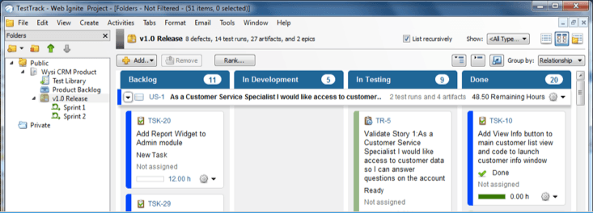
Seapine
Back to Index
SCM and ALM software
History
Characteristics
http://www.seapine.com/
Since 1995, we've provided development and IT organizations with the tools, technologies, and best practices needed to deliver quality software on time and on budget.
Our application lifecycle management (ALM) solutions drive the development of recognized brands, life-saving medical devices, even games of the year.
Manage all product development phases and artifacts—from requirements and user stories through QA cycles and deployment—with ONE SOLUTION
List of 8500 customers is online
Flexible Branching
Code Review
Full Text Search
Workflow
Reporting

Slide 31


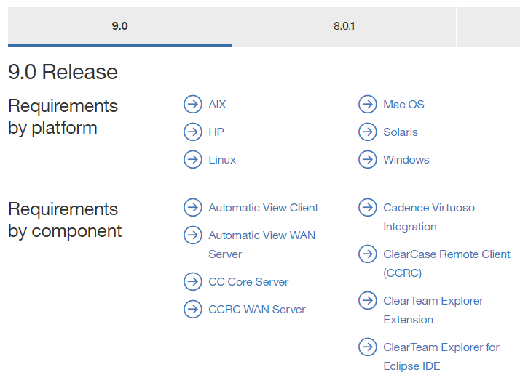
ClearCase
Back to Index
A software configuration management solution
http://www-03.ibm.com/software/products/en/clearcase
IBM® ClearCase® is an enterprise-grade configuration management system that provides highly secure version control with work and build management support. Integrates with other IBM solutions, including IBM Rational® Team Concert™, IBM ClearQuest®, IBM Rational Asset Manager and IBM Rational Application Developer for WebSphere® Software.
Version control and workspace management — manages files, directories, and other development assets across the lifecycle.
Integration with popular development tools including Eclipse, Visual Studio, and Cadence Virtuoso.
Advanced parallel development — includes automatic branching and advanced merging and differencing technology.
.

Slide 32
Code and Infrastructure Build Tools
Back to Index

Slide 33
Code Build Tools
Back to Index
Converting source code into software artifacts
Different tools, same overall concept
Frequent or overnight builds to catch problems early
Support for Source Code Dependency Management
Incremental build processing
Reporting that traces source to binary matching
Build acceleration
Common Tools
Make
Ant
Maven
Gradle
TFS – Team Build
Notes:
Build Automation Tool plugins are critical in Jenkins.
What is Build Automation?
Historically, developers used build automation to call compilers and linkers from inside a build script versus attempting to make the compiler calls from the command line. It is simple to use the command line to pass a single source module to a compiler and then to a linker to create the final deployable object. However, when attempting to compile and link many source code modules, in a particular order, using the command line process is not a reasonable solution. The make scripting language offered a better alternative. It allowed a build script to be written to call, in a series, the needed compile and link steps to build a software application. GNU Make also offered additional features such as "make depend" which allowed some source code dependency management as well as incremental build processing. This was the beginning of Build Automation. Its primary focus was on automating the calls to the compilers and linkers. As the build process grew more complex, developers began adding pre and post actions around the calls to the compilers such as a check-out from version control to the copying of deployable objects to a test location. The term "build automation" now includes managing the pre and post compile and link activities as well as the compile and link activities.
(In recent years, build management tools have provided even more relief when it comes to automating the build process. Both commercial and open source tools are available to perform more automated build and workflow processing. Some tools focus on automating the pre and post steps around the calling of the build scripts, while others go beyond the pre and post build script processing and also streamline the actual compile and linker calls without much manual scripting. These tools are particularly useful for continuous integration builds where frequent calls to the compile process are required and incremental build processing is needed.)

Slide 34


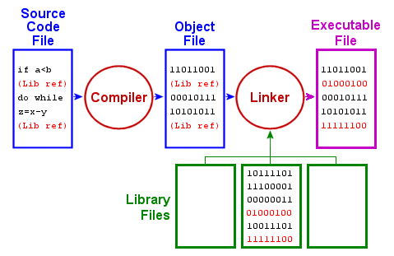
The Make Utility
Back to Index
https://www.gnu.org/software/make/
‘make’ command is used to complete both compiling and linking
Makefile is the input to ‘make’ command
Makefile Describes:
Project structure
Instructions for target creation
Makefile Rule Syntax:
TARGETS: PREREQUISITES
RECIPE
Notes:
The “Make” utility is the beginning of Build Automation. It originated on the Unix platform.
Make consists of the make command and the makefile. The Makefile tells make command how to compile and link a program. Using C/C++ as an example, when a C/C++ source file is changed, it must be recompiled. If a header file has changed, each C/C++ source file that includes the header file must be recompiled to be safe. Each compilation produces an object file corresponding to the source file. Finally, if any source file has been recompiled, all the object files, whether newly made or saved from previous compilations, must be linked together to produce the new executable program. These instructions with their dependencies are specified in a Makefile. If none of the files that are prerequisites have been changed since the last time the program was compiled, no actions take place. For large software projects, using Makefiles can substantially reduce build times if only a few source files have changed.
Jenkins can use make to do the build, by excuting a shell command to invoke make.

Slide 35
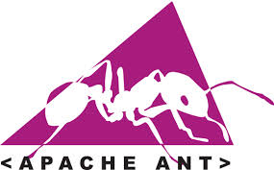
Ant
Back to Index
Build tool
What is Ant?
http://ant.apache.org/
A Java based scripting tool for automating build
Similar to ‘make’
Platform independent
XML based format (build.xml)
Jenkins Ant Build Step
Notes:
Ant – full name is Apache Ant, was a replacement for the make build tool, and was created due to a number of problems with the make. It is similar to Make but is implemented using the Java language, requires the Java platform, and is best suited to building Java projects.
The most immediately noticeable difference between Ant and Make is that Ant uses XML to describe the build process and its dependencies, whereas Make uses Makefile format.
At one time (2002), Ant was the build tool used by most Java development projects.
Because Ant made it trivial to integrate JUnit tests with the build process, Ant made it easy for willing developers to adopt test-driven development, and even Extreme Programming.
After Ant Plugin for Jenkins is installed, you can add build step to invoke Ant, as you can see here.

Slide 36

Maven
Back to Index
Build tool
What is Apache Maven?
https://maven.apache.org/
Maven is a Yiddish word meaning “accumulator of knowledge”
Used for building and managing any Java-based project
Manage all your project dependencies and life-cycle
Used in big and complex projects
Uses pom.xml for dependency mapping
Jenkins Maven Build Step:
Notes:
Contrary to preceding tools like Apache Ant, Maven uses conventions for the build procedure, and only exceptions need to be written down. An XML file describes the software project being built, its dependencies on other external modules and components, the build order, directories, and required plug-ins. It comes with pre-defined targets for performing certain well-defined tasks such as compilation of code and its packaging. Maven dynamically downloads Java libraries and Maven plug-ins from one or more repositories, and stores them in a local cache. This local cache of downloaded artifacts can also be updated with artifacts created by local projects. Public repositories can also be updated.
After Maven Plugin for Jenkins is installed, you can add build step to invoke Maven, as you can see here.

Slide 37


Gradle
Back to Index
Emerge from build hell
http://gradle.org/
Gradle - the modern open source polyglot build automation system.
Automate and integrate your DevOps toolchain with a concise and expressive build programming language. End long build times. End code freezes.
Plugins and integrations with every imaginable tool in the DevOps Automation pipeline from IDEs like Eclipse, Android Studio and IntelliJ to Jenkins through to Chef, Puppet, Docker, and Ansible.
Book provides recipes, techniques, and syntax to help you master build automation.
Uses build.gradle and others for dependencies

Slide 38

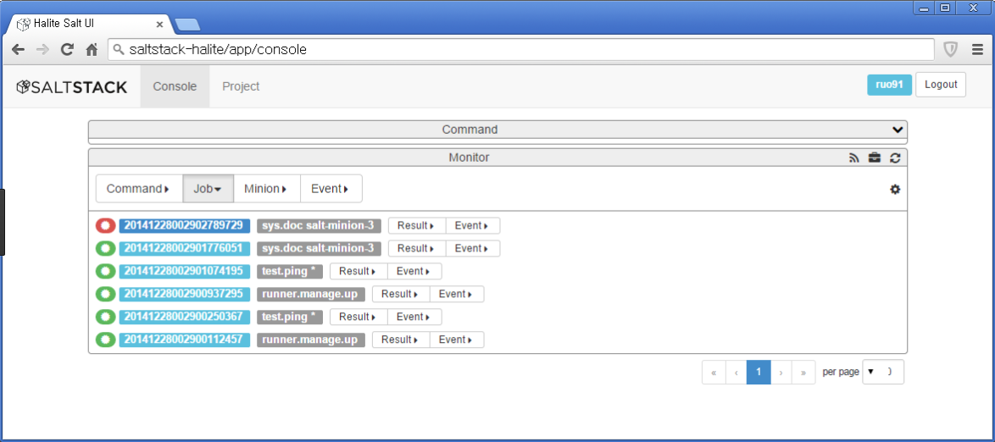
SaltStack
Back to Index
Intelligent orchestration for the software-defined data center
https://saltstack.com/saltstack-enterprise/
Enterprise-grade Salt - SaltStack® Enterprise provides enterprise DevOps and IT operations organizations with the first enterprise-grade customer experience built on the powerful Salt open source platform for IT automation and orchestration.
More scalable, secure & usable - SaltStack® Enterprise is powered by Salt open source software but now offers a completely new graphical user interface made possible by the new SaltStack Enterprise Operations Framework.
Intelligence first - SaltStack Enterprise is the system management software industry’s first intelligent orchestration for the software-defined data center.

Slide 39

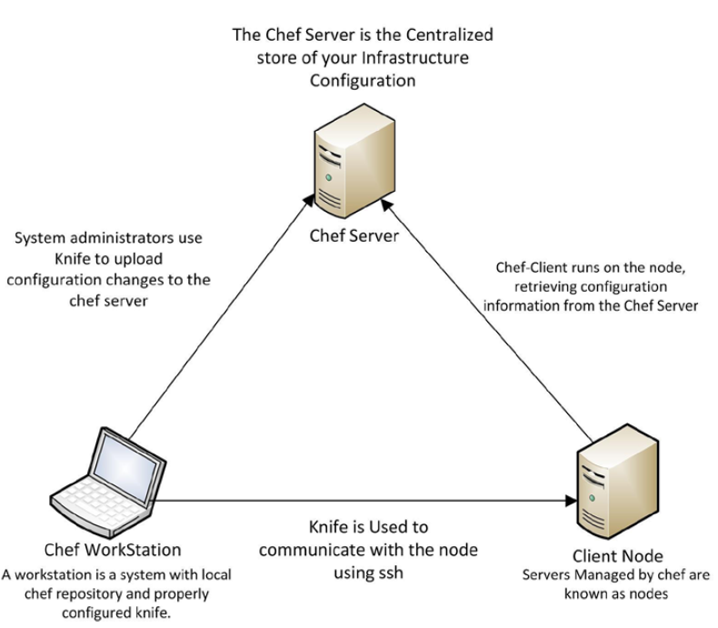
Chef
Back to Index
A Configuration Management Tool
Infrastructure as Code
Structure
https://www.chef.io/chef/
Chef Recipe: describes a series of resources that should be in a particular state
Recipes are written in Ruby DSL (domain-specific language)
Chef corrects any resources that are not in the desired state
Chef Cookbook: Recipes grouped together to define a complete scenario for the deployment and configuration of an application

Slide 40

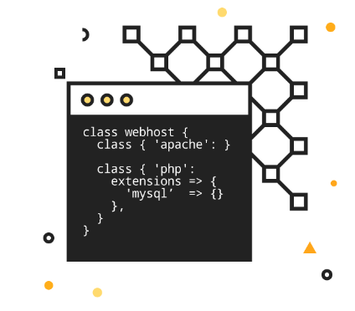
Puppet
Back to Index
Infrastructure as Code
The shortest path to better software
https://puppet.com/
Puppet Manifest: describes a series of resources that should be in a particular state
Manifests are written in Puppet declarative language or Ruby DSL
Puppet corrects any resources that are not in the desired state
For more information, see http://www.puppetlabs.com/

Slide 41
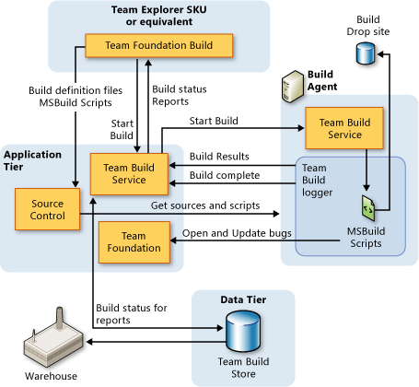
Team Foundation Build
Back to Index
Build Management
https://www.visualstudio.com/en-us/products/tfs-overview-vs.aspx
What is Team Foundation Build?
TF Build link here
Part of Team Foundation Server (TFS)
Part of Visual Studio portfolio
Windows only support
Allows definition, queue, execution, reports
Latest version is 2015

Slide 42
Continuous Integration (CI) and Continuous Delivery (CD) Tools
Back to Index

Slide 43


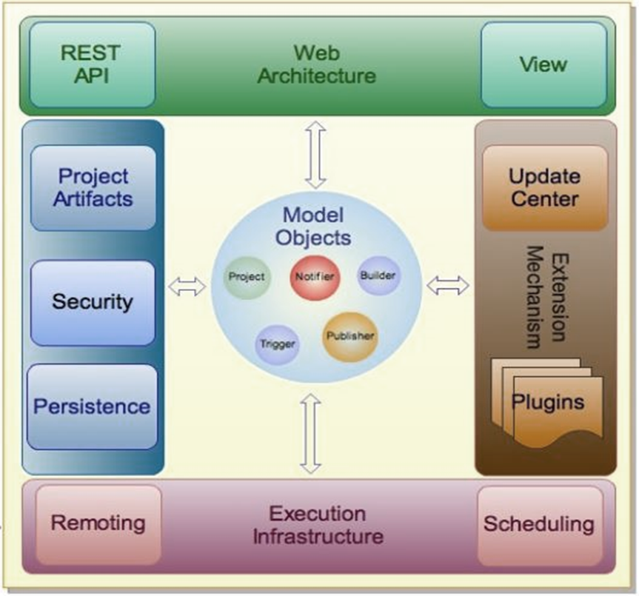
Jenkins / Hudson
Back to Index
A CI server and beyond
https://jenkins.io/
What are Hudson and Jenkins?
A CI tool originally called Hudson
Split into Hudson and Jenkins later
Jenkins now predominates
HPI = Hudson Plug-In
What can you do using Jenkins?
Schedules recurring builds
Schedule and run tests (including HP UFT, etc.)
Performs analysis tasks
Deploy build artifacts
Publishing and Notification
Evolving into CD server and more
Notes:
Hudson is a continuous integration (CI) server tool written in Java.
(about history and Hudson)
The primary developer of Hudson was Kohsuke Kawaguchi, who worked for Sun Microsystems at the time. When Oracle bought Sun, it declared its intention to trademark the Hudson name, and development began on a commercial version. It was decided by the majority of the development community, including Kawaguchi, to continue the project under the name Jenkins in early 2011. Interest in Hudson collapsed thereafter. Eventually Oracle donated the remaining Hudson project assets to the Eclipse Foundation at the end of 2012.
The Hudson project renamed itself Jenkins after a 2010 dispute with Oracle regarding trademarks. Oracle has decided to continue development under the Hudson name. To know the difference between the two, see http://www.coderanch.com/t/622298/tools/Difference-Hudson-Jenkins. In 2012, Oracle formally transferred Hudson project to Eclipse Foundation.
The idea behind continuous integration is to frequently integrate new or changed code from a source repository, with very little time between the commit and the build. When there are many developers are working on the same project, this practice greatly reduces the number of errors that can arise without any developers noticing them. And we all know that the sooner in the lifecycle an error is caught, the less expensive it is to fix.
These systems let you schedule regular builds, automate the build process, and make it self-testing by integrating the execution of automated tests.
If you’d like to know more, I suggest you read the wikipedia article on continuous integration.

Slide 44

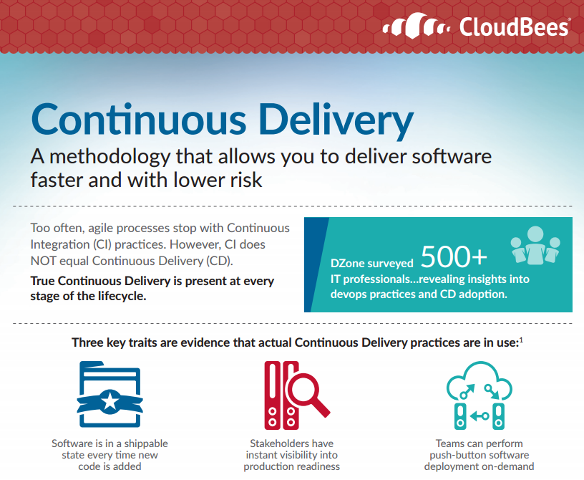
CloudBees
Back to Index
CloudBees: The Enterprise Jenkins Company
https://www.cloudbees.com/
The CloudBees Jenkins Platform is the industry’s most proven, fully featured technology platform for implementing continuous integration (CI) and continuous delivery (CD).
The CloudBees Jenkins Platform extends open source Jenkins with key CloudBees-developed enterprise features and capabilities that are required of mission-critical IT software.
Includes full technical support by a team of Jenkins experts led by Kohsuke Kawaguchi, the creator of Jenkins.
Enterprise-level Security
Advanced Analytics and Monitoring
Optimized Performance
High Availability for Jenkins
Developer productivity
Team management for Jenkins
Continuous Delivery (CD) Pipelines
CI and CD with Docker Containers

Slide 45

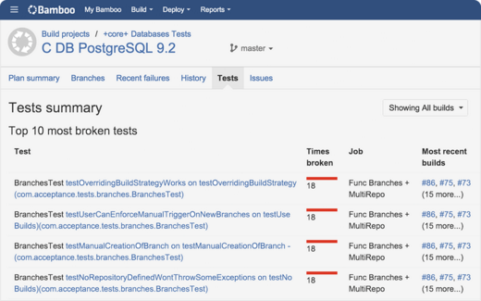
Bamboo
Back to Index
Build, Test, Deploy
https://www.atlassian.com/software/bamboo
Continuous delivery, from code to deployment
Build – Focus on coding and count on Bamboo as your CI and build server! Create multi-stage build plans, set up triggers to start builds upon commits, and assign agents to your critical builds and deployments.
Test – Testing is a key part of continuous integration. Run automated tests in Bamboo to regress your products thoroughly with each change. Parallel automated tests unleash the power of Agile Development and make catching bugs easier and faster.
Deploy – Bamboo offers first-class support for the "delivery" aspect of continuous delivery.
Atlassian

Slide 46

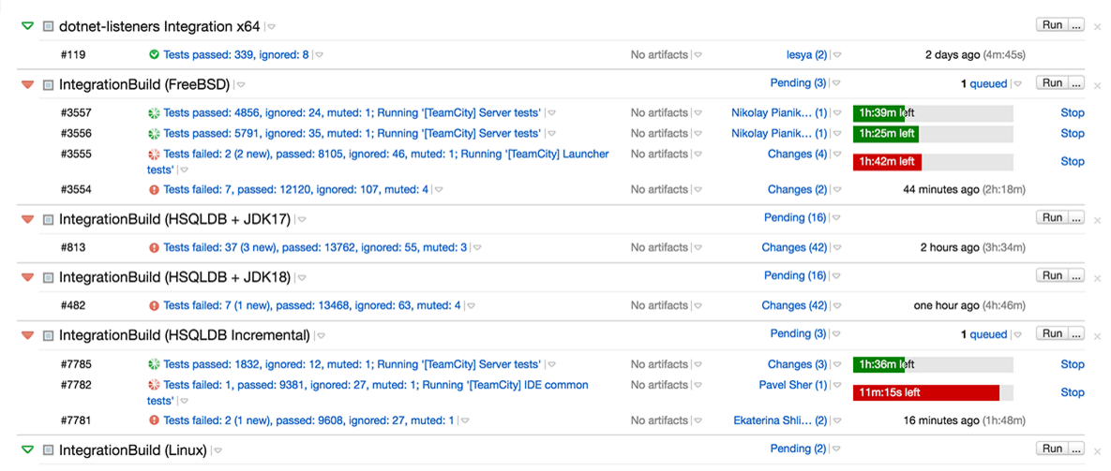
Team City
Back to Index
Powerful Continuous Integration out of the box
https://www.jetbrains.com/teamcity/
Perform better – Do you practice a traditional approach to Continuous Integration, or prefer Feature Branches with Git or Mercurial? Offers a wide range of developer-oriented features to take your team's performance to the next level.
Extend as you go – Whenever you need special additional functionality, choose from over 100 ready-to-use plugins. Or, add custom features by creating your own plugins using the TeamCity Open API.
Integrate and deploy continuously – Initially a Continuous Integration server, TeamCity has encompassed all the features you expect from a mature Continuous Deployment platform.
Free Forever (20 build configurations, 3 build agents)
JetBrains

Slide 47

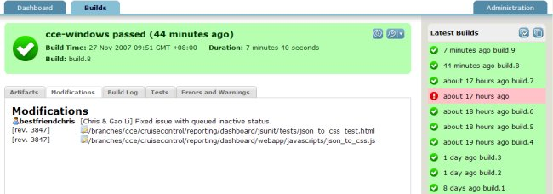
CruiseControl
Back to Index
Open source continuous integration
http://cruisecontrol.sourceforge.net/index.html
Cruise Control was the first of the CI servers.
CruiseControl is both a continuous integration tool and an extensible framework for creating a custom continuous build process. It includes dozens of plugins for a variety of source controls, build technologies, and notifications schemes including email and instant messaging.
CruiseControl is written in Java but is used on a wide variety of projects. There are builders supplied for Ant, NAnt, Maven, Phing, Rake, and Xcode, and the catch-all exec builder that can be used with any command-line tool or script.
100% open source software.

Slide 48

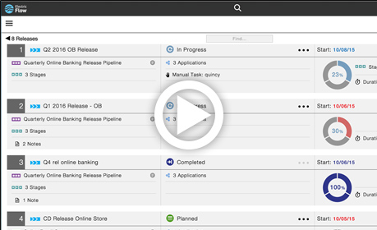
Electric Cloud
Back to Index
Deliver anything Faster
http://electric-cloud.com/
Electric Flow - Shared visibility and control over enterprise DevOps tools and CD pipelines
ElectricFlow orchestrates and automates all of your DevOps tools in the software delivery processes from code check-in through release. ElectricFlow boosts productivity, lowers costs, eliminates risks of failed releases, and decreases time it takes to deliver new capabilities to customers.
ElectricFlow has hundreds of plugins for popular CI, CD, CM tools.
Build / Test, Deploy, Release

Slide 49


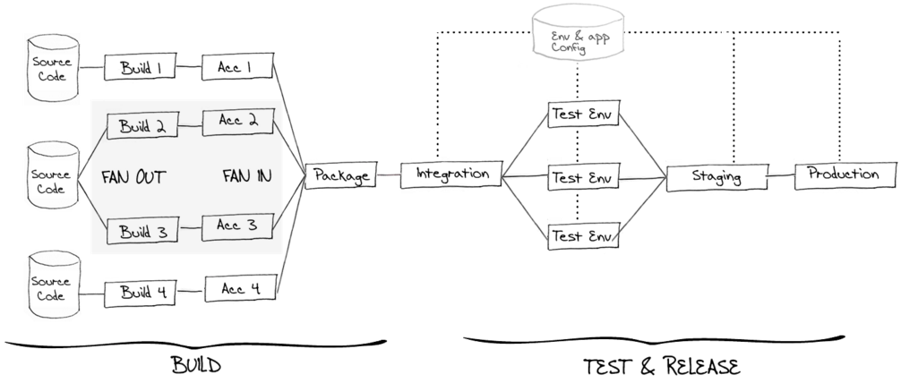
Go
Back to Index
Performance. Support. Reliability.
https://www.thoughtworks.com/go/
Automate and streamline the build-test-release cycle for worry-free, continuous delivery of your product.
PIPELINES AT THE CORE – Model even the most complex build & deploy workflow with ease. Unlike CI servers, Go was built from the ground up with pipelines in mind. Go makes it simple to model failing fast, artifact promotion, self-service environments and single-click deployment.
MEANINGFUL VISIBILITY – Go's Value Stream Map visualizes your entire CD workflow. With a single glance you can trace a change from commit to deployment.
Also Snap (CD), Mingle (AGM) and Gauge (Test).
ThoughtWorks

Slide 50
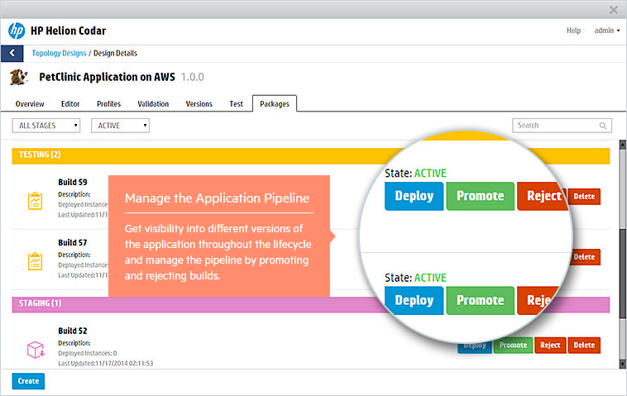
HPE Codar
Back to Index
Continuous deployment made easy
http://www8.hp.com/us/en/software-solutions/codar-continuous-deployment/
Codar – A continuous deployment solution that provides automation and release management of complex multi-tier applications across the application lifecycle.
Automate the deployment of your applications by using a graphical topology designer, trigger deployments with Jenkins, and embrace existing content from Chef, Docker, Amazon Web Services, and more.
Unique Application Modelling – Use a unique, simple declarative approach with reusable components.
Application Pipeline Management – Get visibility and enforce continuous deployment requirements.
Extensive out-of-the-box integrations.

Slide 51

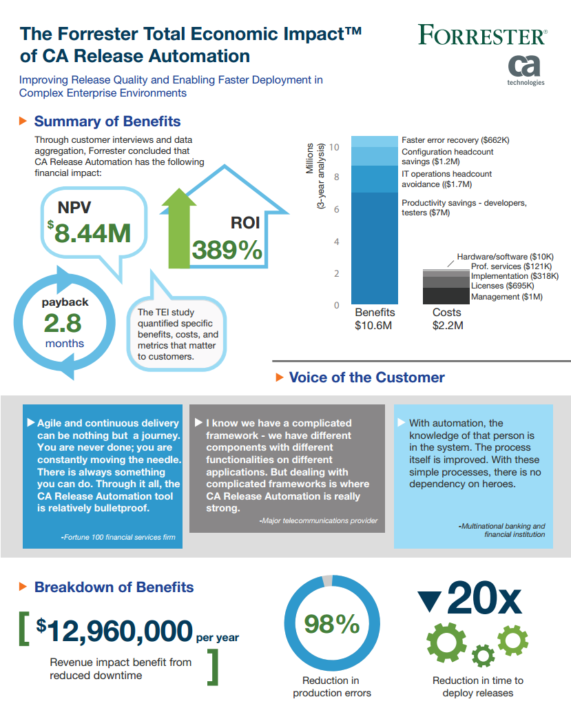
CA Release Automation (Nolio)
Back to Index
Take control of the release pipeline
http://www.ca.com/us/products/ca-release-automation.html
Get reliable, rapid application deployment that’s ready to work in your IT world.
Deploy apps at pace with agile development and let customer satisfaction soar.
Take control of the release pipeline.
Accelerate releases to market—on demand.
Manage the scale of agile application deployment.

Slide 52

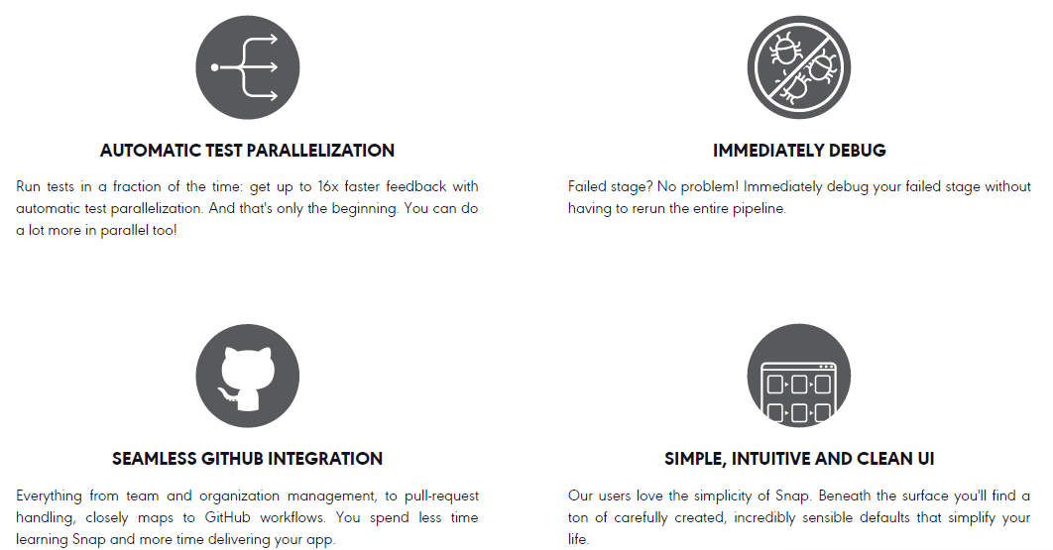
Snap
Back to Index
MINIMUM EFFORT, MAXIMUM DELIVERY
https://snap-ci.com/
Snap – Continuous Integration and Delivery in the cloud.
Deployment Pipelines – Model your build as a sequence of stages, from the fastest tests to the more comprehensive ones. As each stage passes, your application becomes increasingly production-ready
Automatic Test Parallelization
Branch Tracking and Integration Pipelines
Pull Request Integration
ThoughtWorks

Slide 53
Integrated Development Environments (IDE’s)
Back to Index

Slide 54

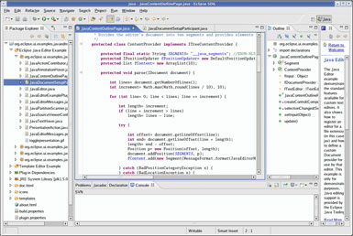
Eclipse
Back to Index
Java Code Editor
What is Eclipse?
https://eclipse.org/
Open source originated from IBM VisualAge
Advanced UI used for editing code
Supports Ada, ABAP, C, C++, COBOL, Fortran, JavaScript, Perl, PHP, Python, R, Ruby/rails, Groovy, etc.
Very large Eclipse Marketplace tools (> 1500)
Competes with NetBeans and IntelliJ editors
Latest version is 4.5 (Mars)

Slide 55

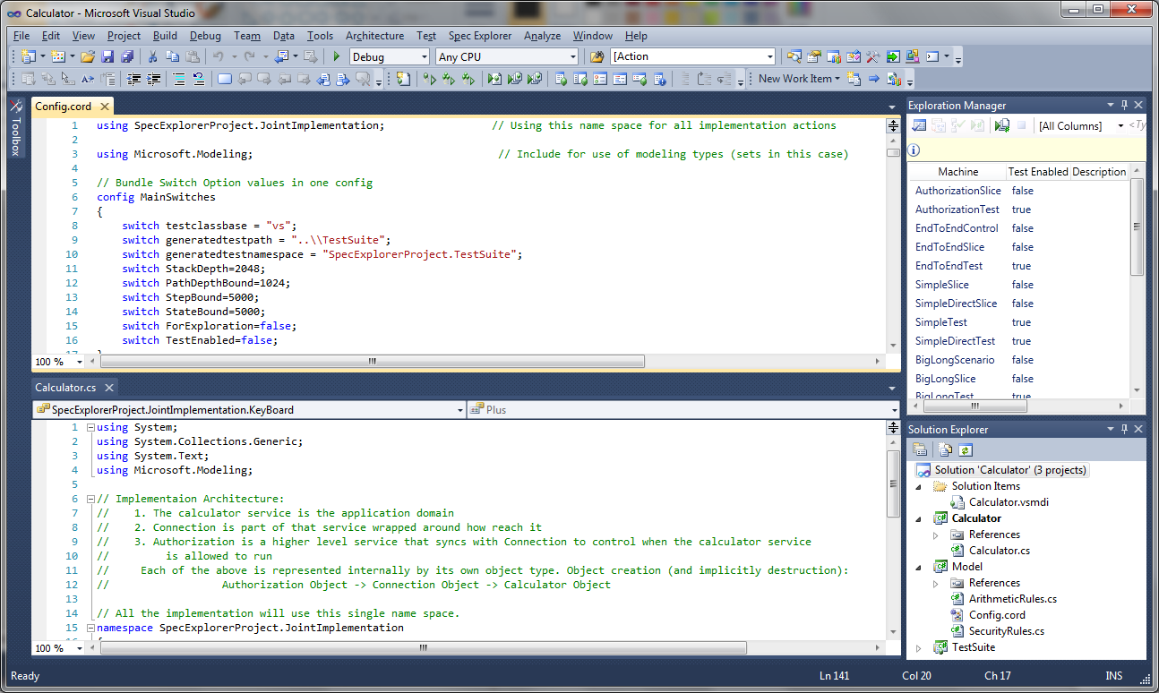
Visual Studio
Back to Index
Microsoft IDE
What is Visual Studio?
https://www.visualstudio.com/en-us/visual-studio-homepage-vs.aspx
Microsoft’s native IDE
Pricing is $300 - $4000/copy depending on features
VS Community edition is free for certain purposes (training, demos, etc.)
Also referred to as MSVS
Advanced UI used for editing Visual C++, Visual Basic, JavaScript, F#, .NET code
Latest version is 2015

Slide 56

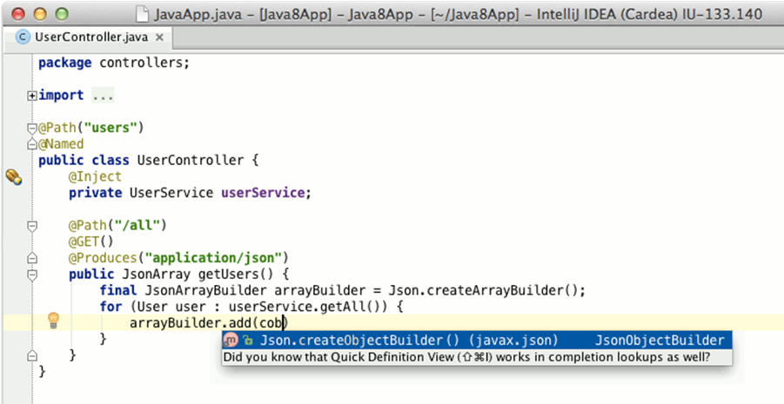
IntelliJ IDEA
Back to Index
Capable and Ergonomic Java* IDE *and much more
https://www.jetbrains.com/idea/
IntelliJ IDEA offers powerful static code analysis and ergonomic design making development not only productive but also enjoyable.
Deep intelligence – After IntelliJ IDEA's indexed your source code, it offers blazing fast and intelligent experience by giving relevant suggestions in every context
Out-of-the-box experience – Mission-critical tools such as integrated version controls systems and a wide variety of supported languages and frameworks are at hand.
Solutions for Java, C++, Ruby, .NET, PHP
Android Studio is built upon IntelliJ
Community edition is free.
.
JetBrains

Slide 57

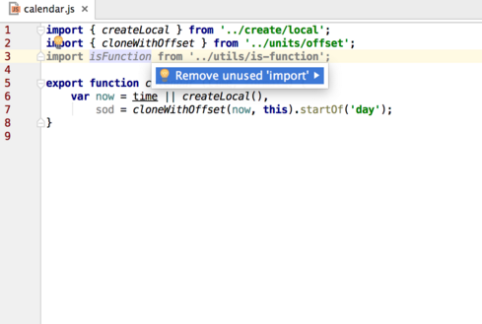
WebStorm
Back to Index
The smartest JavaScript IDE
https://www.jetbrains.com/webstorm/features/
Build tools – Enjoy a simple unified UI for running Grunt,Gulp or npm tasks right from the IDE. All tasks are listed in a special tool window, so simply double-click on the task name to start it.
Code quality tools – In addition to hundreds of WebStorm’s own inspections, it can run JSHint, ESLint, JSCSor JSLint against your code and highlight any issues on the fly, right in the editor.
Project templates – Start new projects from the Welcome screen using popular project templates likeExpress or Web starter kit, and access even more project generator thanks to integration with Yeoman.
JetBrains

Slide 58

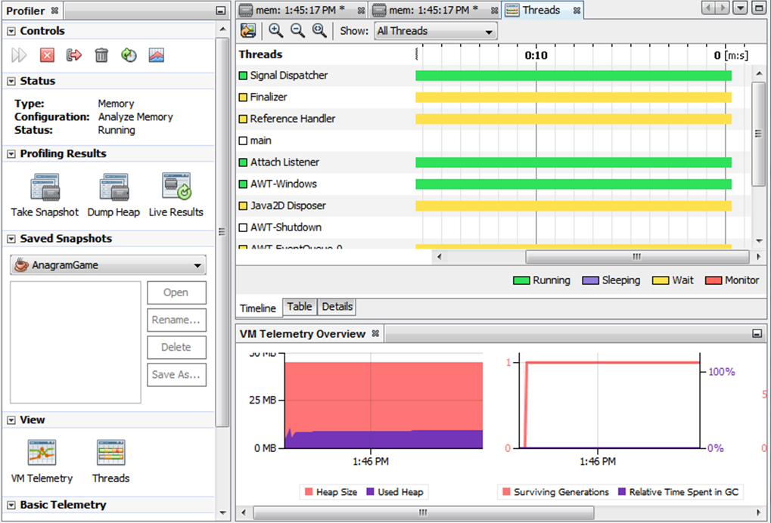
NetBeans
Back to Index
The Smarter and Faster Way to Code
What is NetBeans?
https://netbeans.org/
Open source originally developed by Sun/Oracle
Used to develop Java, C/C++, XML and HTML, to PHP, Groovy, Javadoc, JavaScript and JSP
Provides code templates, coding tips, and refactoring tools
Includes NetBeans GUI Builder
Latest version is 8.1

Slide 59

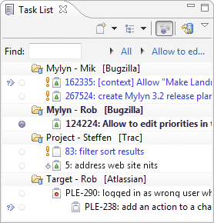
Mylyn
Back to Index
A Task-Focused Interface for Eclipse
http://www.eclipse.org/mylyn/
Mylyn is a subsystem of Eclipse for task management.
Mylyn is an open source implementation of the Task-Focused Interface, it's also an application lifecycle management (ALM) framework for Eclipse.
The revolutionary task-focused interface Realigns the IDE around tasks so that you see only the code that's relevant
A task management tool for developers Averaging 1 million downloads/month, Mylyn is the most popular IDE tool for ALM
A broad ecosystem of Agile and ALM integrations Dozens of extensions integrate Mylyn with ALM and developer collaboration tools

Slide 60
Behavior Driven Development (BDD) Tools
Back to Index

Slide 61

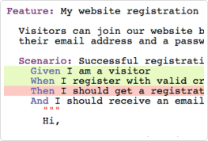
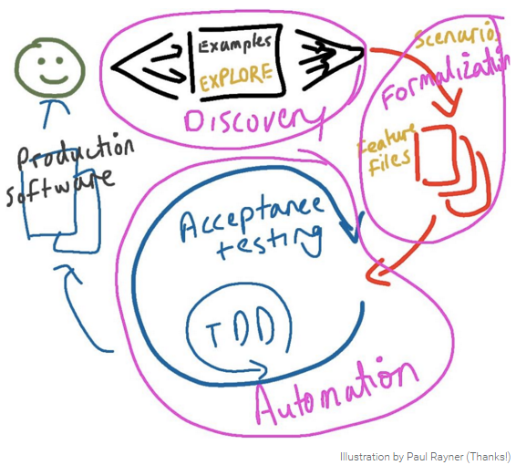
Cucumber
Back to Index
Simple, human collaboration
https://cucumber.io/
Allows the execution of feature documentation written in business-facing text
Step Definitions define the code to run for each step in a Gherkin's .feature file
A single source of truth – Cucumber merges specification and test documentation into one cohesive whole.
Focus on the Customer – Cucumber's executable specifications encourage closer collaboration, helping teams keep the business goal in mind at all times.
Work well with Selenium for browser automation
Plugins exist for integrating with popular CI tools and IDEs

Slide 62

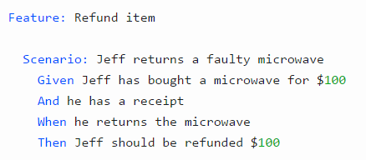
Gherkin
Back to Index
The language Cucumber uses to define test cases
The main keywords are:
Feature
Scenario
Given, When, Then, And, But (Steps)
Background
Scenario Outline
Examples
https://cucumber.io/docs/reference#gherkin
Gherkin is the language that Cucumber understands. It is a Business Readable, Domain Specific Language that lets you describe software's behavior without detailing how that behavior is implemented.
Gherkin serves two purposes
Documentation
Automated tests
Seeks to enforce firm, unambiguous requirements
Supports keywords in dozens of natural languages

Slide 63
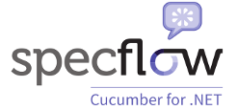
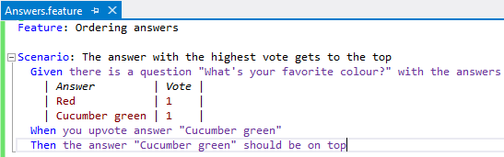
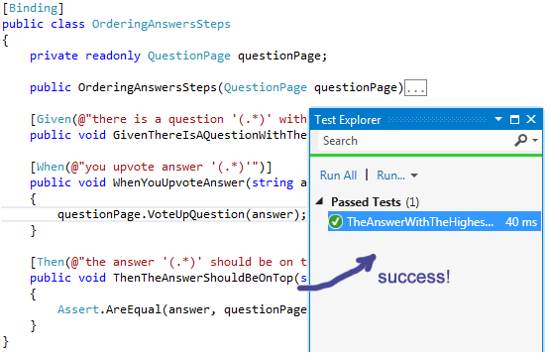
SpecFlow
Back to Index
Binding business requirements to .NET code
http://www.specflow.org/
Specify! – Describe the behavior of your system using human-readable syntax. Define specifications in the problem domain using the language of your stakeholders and build up a living documentation of your system.
Automate! – Bind your test specifications to your application code to automate the testing of your system. Ensure that all your tests pass!
Develop! – Run your automated tests periodically to ensure that any changes to your system have not introduced errors. Refactor existing test cases and extend your test suite with new ones as your system evolves with your stakeholders’ needs.

Slide 64


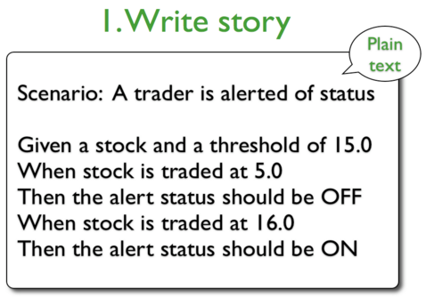
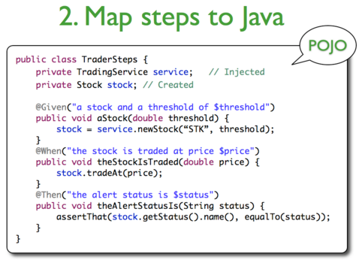
JBehave / NBehave
Back to Index
BDD for Java and .NET
http://jbehave.org/
https://github.com/nbehave/NBehave
JBehave is a framework for Behaviour-Driven Development (BDD). BDD is an evolution of test-driven development (TDD) and acceptance-test driven design, and is intended to make these practices more accessible and intuitive to newcomers and experts alike.
Eclipse Plug-in
Nbehave is based on Dan North's initial vision of rbehave and utilizing the behavioral domain specific language (DSL) of Behavior Driven Design (BDD). The primary goal of NBehave is a framework for defining and executing application requirement goals.
100% open source software.

Slide 65

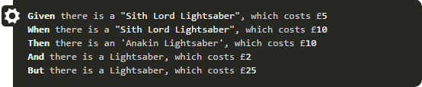
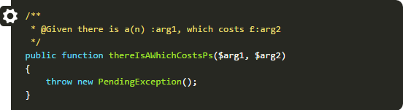
Behat
Back to Index
BDD for PHP
http://docs.behat.org/en/v3.0/
Behat is an open source Behavior Driven Development framework for PHP 5.3+. What’s behavior driven development, you ask? It’s a way to develop software through a constant communication with stakeholders in the form of examples; examples of how this software should help them, and you, to achieve your goals.
The official way to install Behat is through Composer. Composer is a package manager for PHP. If you don’t have Composer already, see the Composer documentation for instructions. After that, just go into your project directory (or create a new one) and run:
$ php composer.phar require --dev behat/behat=~3.0.4.
100% open source software.

Slide 66
Test Management Tools
Back to Index

Slide 67

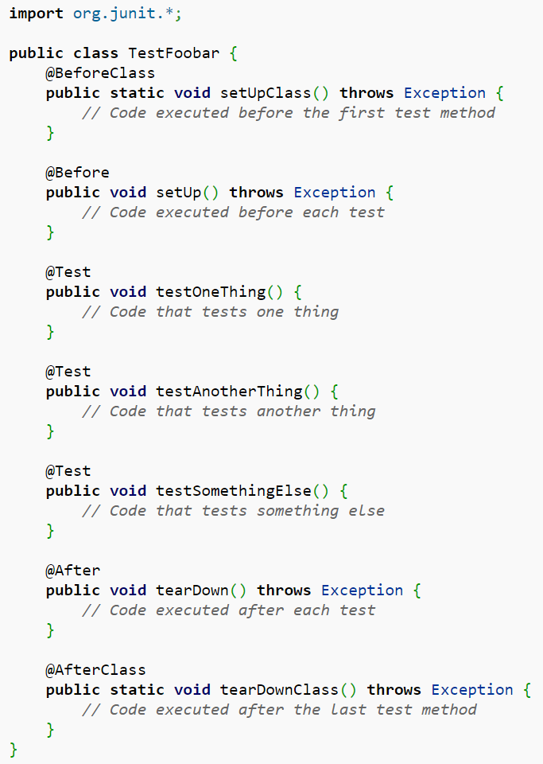
JUnit
Back to Index
http://junit.org/junit4/
One of the xUnit family tools
JUnit is the unit testing framework for Java
Important in test-driven development
Linked as a JAR at compile-time
One of the most popular libraries used by Github projects
Example of a JUnit test fixture:
Notes:
There’re many such frameworks. One well-know family of test frameworks is called xUnit, which includes Junit for Java, Nunit for Microsoft .Net, Runit for Ruby, etc.
Taking Junit as an example, you can see that it has a structure that allow you to set up the isolation for your unit test, and tear it down after the test. Junit works in conjunction with tools that provide mock or fake.

Slide 68

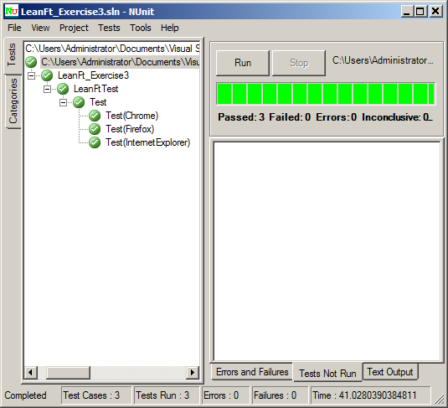
NUnit
Back to Index
http://www.nunit.org/
NUnit is a unit-testing framework for all .Net languages. Initially ported from JUnit, the current production release, version 3.0, has been completely rewritten with many new features and support for a wide range of .NET platforms.
One of the xUnit family tools
Important in test-driven development
Implemented as an included library
NUnit is Open Source software
Notes:
There’re many such frameworks. One well-know family of test frameworks is called xUnit, which includes Junit for Java, Nunit for Microsoft .Net, Runit for Ruby, etc.
Taking Junit as an example, you can see that it has a structure that allow you to set up the isolation for your unit test, and tear it down after the test. Junit works in conjunction with tools that provide mock or fake.

Slide 69
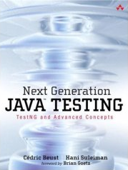
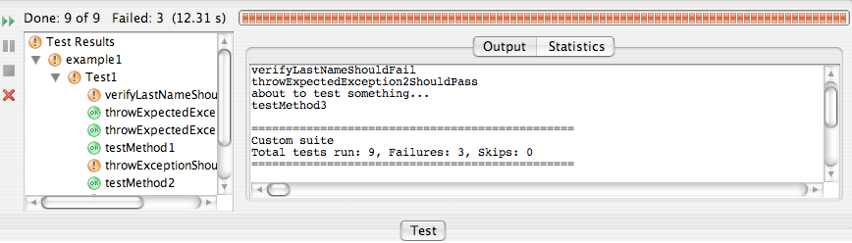
TestNG
Back to Index
Next Generation Java Testing
http://testng.org/doc/index.html
TestNG (Next Generation) is a testing framework inspired from JUnit and NUnit but introducing some new functionalities that make it more powerful and easier to use.
IDE Plug-ins:
Eclipse
Intellij IDEA
NetBeans
Annotations
Test that your code is multithread safe
Flexible test configuration
Support for data-driven testing (with @DataProvider) and parameters

Slide 70

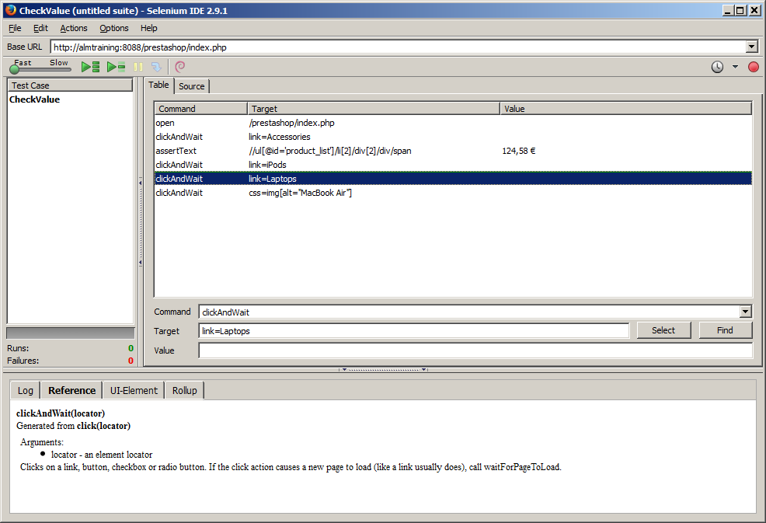
Selenium
Back to Index
Selenium automates browsers
http://www.seleniumhq.org/
Selenium IDE
Creates quick bug reproduction scripts
Creates scripts to aid in automated exploratory testing
Selenium WebDriver
Creates robust, browser-based regression automation suites and tests
Scale and distribute scripts across many environments
Selenium Grid offers parallel execution
Primarily used for automating web applications for testing purposes.
Developed by Jason Huggins in 2004 at ThoughtWorks (Selenium Remote Control)
In 2007, Simon Stewart at ThoughtWorks developed WebDriver
Selenium IDE
ThoughtWorks*

Slide 71

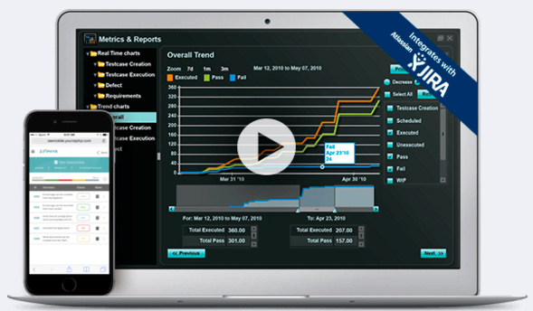
Zephyr
Back to Index
Real-time Test Management
http://www.getzephyr.com/products
Enterprise Test Management – Manage all aspects of software quality; integrate with JIRA and various test tools, all within the enterprise.
Comprehensive suite of test management products that fosters global project team collaboration, drives down costs, shortens release cycles, and provides real-time visibility into the status and quality of software projects.
Addresses the problems of making the transition to agile, challenges around globally distributed teams, slow release cycles, sub-standard quality, business decisions based on stale data, and ever changing tool sets.
Requires Jira for integration

Slide 72

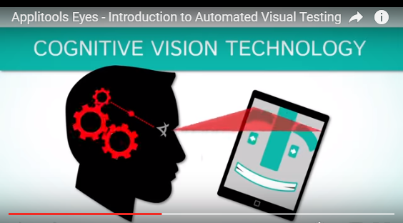
Applitools
Back to Index
Automating visual software testing
https://applitools.com/
Applitools Eyes – Automated testing of all the visual aspects of your application
Easy integration with existing test automation and ALM frameworks
Seamless testing on multiple platforms, screen-resolutions and form-factors
Visual self-explanatory logs
Verifies that the GUI appears correctly across all devices and browsers
Easily scale up with unlimited concurrent test runs in the cloud

Slide 73

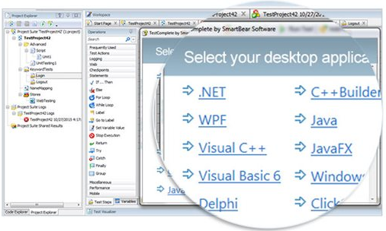

SmartBear
Back to Index
QUALITY TOOLS FOR THE CONNECTED WORLD
https://smartbear.com/
Very similar portfolio to HPE
Products:
API Tools
SoapUI NG Plus
Secure Pro
SwaggerHub
Testing
TestComplete (Desktop, Web, Mobile)
LoadComplete
QA Complete
TestLeft
Monitoring
AlertSite

Slide 74


BrowserStack
Back to Index
Live, Web-Based Browser Testing
https://www.browserstack.com/
Instant access to all real mobile and desktop browsers. Say goodbye to your lab of devices and virtual machines.
Allows testing on 500+ different browser platform, operating system and device combinations.
Real Device Cloud – Test on a range of physical Android and iOS mobile devices and tablets for the most accurate results.
Selenium cloud testing in 700+ Real Desktop and Mobile Browsers
Rapid Selenium WebDriver testing with 100% reliability.
Responsive design testing
”Just played around with BrowserStack: Quite cool, instant access to a browser in a VM with dev tools.”

Slide 75


Sauce Labs
Back to Index
A cloud-hosted web + mobile app automated test platform
https://saucelabs.com/
One of the founders is the creator of Selenium (Jason Huggins)
Comprehensive test infrastructure using Selenium, Appium and JavaScript unit testing frameworks
Easily scale to speed up test cycles and boost capacity without the hassle of managing infrastructure
Provides a secure testing protocol for testing applications behind customer firewalls
Offers automated testing for Continuous Integration (CI) and Continuous Delivery (CD) pipelines
The easiest way to manually test your app across over 700 browser/OS combinations

Slide 76


Tosca (Tricentis)
Back to Index
Take your software testing to the next level
http://www.tricentis.com/tricentis-tosca-testsuite/
Tricentis Tosca Testsuite is an effective end-to-end testing suite for enterprises.
Optimize Risk Coverage by minimizing the number of test cases to achieve the highest possible risk contribution for each test case.
Manage Test Data by offering a fully integrated set of capabilities for the design, generation and provisioning of test data.
Automate test cases using our unique Model-Based Test Automation approach. Tosca Testsuite delivers performance improvement in testing efficiency by a factor of 10.
Agile, SAP, Java, Manual, Service Virtualization

Slide 77


Gauge
Back to Index
Simple. Collaborative. Adaptable
http://getgauge.io/
Write tests in plain-speak and refactor fearlessly so your test suite adapts as your application evolves. Gauge’s pluggable architecture allows you to customize your environment so you can write tests in the language and IDE of your choice.
Write test specifications in Markdown. Gauge won't enforce a structure: write in a way that works for you.
Gauge is lightweight and easy to get started. Install and initialize with a single command.
Gauge supports C#, Java, Ruby, IntelliJ and Visual Studio out-of-the-box.
Data Driven Execution – Easily test with large data sets, while keeping specifications highly readable. Gauge reads test data from text, CSV, and more.
ThoughtWorks

Slide 78


FitNesse
Back to Index
FitNesse is the acceptance test wiki.
http://www.fitnesse.org/
Be-monster not thy feature, wer't my fitnesse – Shakespeare, King Lear
The fully integrated standalone wiki and acceptance testing framework.
It's a Collaboration tool – Since FitNesse is a wiki web server, it has a very low entry and learning curve, which makes it an excellent tool to collaborate with.
It's a Test tool – The wiki pages created in FitNesse are run as tests. The specifications can be tested against the application itself.
It's Open – FitNesse is an open source project. The code base is not owned by any company. A lot of information is shared by the FitNesse community.

Slide 79


HPE ALM Octane
Back to Index
Deliver applications with speed, quality, and scale
https://saas.hpe.com/en-us/software/alm-octane
Plan
Quickly assess the progress of your projects and capture and track requirements with built-in support for agile methodologies.
Define
Use a standardized, collaborative workspace to build and prioritize backlog items and track them across the lifecycle.
Build
Get insight with the collection of build data and take advantage of the support for continuous testing and build execution.
Test
Manage quality throughout the lifecycle, with support for testing in a structured language and transitioning from manual to automated tests.
Track
View quality aggregation in context of an entire application and track progress across the lifecycle.

Slide 80
Mobile App Environments
Back to Index

Slide 81


HPE Mobile Center
Back to Index
An end-to-end quality lab of real devices and emulators
https://saas.hpe.com/en-us/software/mobile-testing
Smart analytics for better testing - Mobile analytics offer you actionable insights you can use to improve your app and how you test it.
Realistic user acceptance testing - HPE NV for Mobile will mimic your users’ experience by modeling accurate mobile-specific use cases and gesture-based scenarios on multiple real devices.
Automated testing on real devices - Object-based automation, easy maintenance, and smart reports help you increase test coverage and speed up test cycles.
Structured exploratory testing
Mobile performance optimization
End-to-end Mobile Security

Slide 82


Appium
Back to Index
Automation for Apps
http://appium.io/
Sponsored by Sauce Labs
Appium is an open source test automation framework for use with native, hybrid and mobile web apps. It drives iOS and Android apps using the WebDriver protocol.
Appium Philosophy – Appium is built on the idea that testing native apps shouldn't require including an SDK or recompiling your app. And that you should be able to use your preferred test practices, frameworks, and tools. Appium is an open source project and has made design and tool decisions to encourage a vibrant contributing community.
Exposes a REST API (Selenium WebDriver) and responds with HTTP responses.

Slide 83

Appium
Back to Index
Selenium for Mobile
http://appium.io/
Built to test mobile apps of all kinds (native, hybrid, and mobile web)
Drives iOS and Android apps using the WebDriver protocol
No need to recompile app or modify it in order to automate it
Free to use any programming language to write test scripts
UIAutomator
(API Level >=17)
bootstrap.jar on mobile device
WebDriver protocol
Appium Server
Test Scripts
Selendroid
(API Level <17)

Slide 84


Android Studio
Back to Index
The Official IDE for Android
http://developer.android.com
Android Studio provides the fastest tools for building apps on every type of Android device.
Implemented in IntelliJ
World-class code editing, debugging, performance tooling, a flexible build system, and an instant build/deploy system all allow you to focus on building unique and high quality apps.
Includes Android SDK
Emulator only requires SDK and not full Android Studio
100% open source software.
Next gen = Android N Developer

Slide 85

Xcode
Back to Index
Tools you’ll love to use
https://developer.apple.com/xcode/
Xcode 7 IDE includes everything you need to create amazing apps for iPhone, iPad, Mac, Apple Watch, Apple TV. The Swift programming language has been updated and is now faster than ever, with great features that make your code even easier to read and write.
No real emulators
TestFlight distributes app to set of emails for testing.
Testing – Test-driven development is a first-class workflow in Xcode. The Test Navigator makes it easy to jump to any test in your project, execute an individual test, or execute a group of tests. The Assistant editor has new test-specific views that automatically track which tests exercise the code you are editing, keeping your tests and code in sync.

Slide 86


Experitest
Back to Index
E2E Mobile DevOps Quality Tools
https://experitest.com/
SeeTest – Cloud – Onsite device lab that can be remotely accessed by different testing teams
SeeTest – Automation – Test automation tool for mobile – same test runs on different devices
SeeTest – Manual – Test manually on remote devices located in your onsite device lab (SeeTestCloud
SeeTest – Network Virtualization – Emulate real world network conditions to test actual user experience of your users
Mobile Add-On For LoadRunner – Connect Real Mobile Devices and See How Your Application Performs Under Synthetic Load
Mobile Add-on for UFT – Extend UFT/QTP for mobile test automation

Slide 87


Genymotion
Back to Index
Work Better, Faster, Together
https://www.genymotion.com/
Android Emulator
Speed up your development lifecycle with an easy, accessible, and effective testing and collaboration tool
Say no to bugs – Bugs are more and more expensive to fix the further along you are in development. Test soon and test often to eliminate pesky bugs before they cause too much trouble (and cost you users.)
Test with your eyes closed, literally – Genymotion integrates with your continuous integration server, like Jenkins or Gradle, so you can automatically run the tests you've written, even when you aren't there.
One platform, many options – The Genymotion emulator has over 3,000 Android configurations to choose from.

Slide 88


Keynote by Dynatrace
Back to Index
Test on Real Devices in the Cloud
http://www.keynote.com/solutions/testing/mobile-testing
Largest interactive device library – The DeviceAnywhere Cloud contains the largest interactive mobile device library available—including the most current and popular smartphones and tablets
Total Device Control – Interact and control every aspect of a mobile device using Keynote’s patented Direct-to-Device® technology. Any action that can be performed on a mobile device in-hand can be replicated on Keynote devices in the cloud.
Powerful Test Automation & Scripting – Increase the speed and throughput of your testing with Keynote’s robust test automation and scripting engine purpose-built for mobile apps and websites.

Slide 89
Issue Tracking Tools
Back to Index

Slide 90




Atlassian Products
Back to Index
Products related to ALM
PLAN, TRACK, & SUPPORT
COLLABORATE & CHAT
CODE, BUILD, & SHIP
Atlassian

Slide 91


Jira
Back to Index
Agile, from end to end
https://www.atlassian.com/software/jira
Scrum boards – Agile teams can stay focused on delivering iterative and incremental value, as fast as possible, with customizable scrum boards.
Kanban boards – Flexible kanban boards give your team full visibility into what’s next so you can continuously deliver maximum output in minimal time.
Agile reporting – Teams have access to more than a dozen out-of-the-box reports with real-time, actionable insights into how their teams are performing.
Portfolio planning – Get visibility across all teams and projects with Portfolio for JIRA. Forecast realistic roadmaps, manage team resources and track progress with real-time planning.
Lots of plug-ins
Atlassian

Slide 92


BugZilla
Back to Index
Server software to help manage software development
https://www.bugzilla.org/
Optimized database structure for increased performance and scalability
Excellent security to protect confidentiality
Advanced query tool that can remember your searches
Integrated email capabilities
Editable user profiles and comprehensive email preferences
Comprehensive permissions system
Proven under fire as Mozilla's bug tracking system

Slide 93


YouTrack
Back to Index
Empower your whole DEV team
https://www.jetbrains.com/youtrack/
Smart search – Find anything you need in no time, using smart search queries with completion.
Keep your hands on the keyboard – Speed up the daily routine with handy shortcuts, just like you do in your favorite IDE.
Command window – Modify multiple issues at once using geek-style commands.
Scrum or Kanban – Follow Scrum, Kanban or a mixed process to visualize your team’s progress.
Solutions for Java, C++, Ruby, .NET, PHP
Free 10 user pack.
JetBrains

Slide 94
ChatOps
Back to Index
Conversations put to work

Slide 95


Slack
Back to Index
A messaging app for teams
https://slack.com/
Conversations are organized into channels.
Drag and drop documents, videos, files.
Fully searchable conversations and content.
Other systems can feed into Slack (e.g. Twitter, etc.)
Conversations sync’d on all devices.
Goal is to basically eliminate email.
Free version includes:
Search and browse 10k most recent messages
10 service integrations
Free native apps for iOS, Android, Mac & Windows Desktop

Slide 96


HipChat
Back to Index
Group and private chat, file sharing, and integrations
https://hipchat.com/
Persistent, searchable, includes: video calling, screen sharing, and the security your IT team craves.
Run it on everything – Your team will never miss an important message with apps available on Mac, Windows, iOS, Android, and Linux. Also web app.
Serious integrations – HipChat integrates with the services your team uses everyday. Get notifications and stay up-to-date with services like JIRA, Bitbucket, GitHub, Asana, Google Hangouts, Zendesk, 150+ more
Free version includes (unlimited users/integrations):
Group chat
Instant messaging
File sharing
Atlassian

Slide 97
Performance Engineering Tools
Back to Index

Slide 98


Gatling
Back to Index
Arm yourself for performance
http://gatling.io/
Open Source, load-testing framework based on Scala, Akka and Netty
High performance
Ready to present HTML reports
Scenario recorder and developer-friendly DSL
Write your scenarios with our scripting API or directly in Scala
Easy-to-read and developer-friendly
Easier maintainability

Slide 99


Blazemeter
Back to Index
Performance Testing for the Continuous Delivery Era
https://www.blazemeter.com/
Run and analyze JMeter and other open source-based load tests from anywhere in the world.
Performance Testing as Code – Run massively scalable, open source-based performance tests against all of your apps, from classic web and mobile to microservices and APIs, and validate performance at every software delivery stage.
Open Source Compatible – Design and execute load tests at massive scale using leading open source tools, such as: JMeter, Selenium, Gatling and Locust.
Mobile Performance Testing – Record, create and run realistic mobile tests on real devices and networks.
Continuous Integration Testing – Automate your testing throughout the development lifecycle

Slide 100


HPE StormRunner Load
Back to Index
Release Robust Products That Scale
https://saas.hpe.com/en-us/software/stormrunner-load
SaaS delivered cloud load and performance testing solution that makes it easy to plan, run, and scale web and mobile testing.
Easy and Simple – Easy to design & create a cloud-based mobile and web load test in under 10 minutes.
Intelligent and Predictive Analytics – Detect problems fast. Emulate and test real-world network conditions with Network Virtualization to get accurate and repeatable results.
Scalable and Global – Scale from 1 tester to 1,000,000 or more geographically distributed web and mobile users.

Slide 101


HPE LoadRunner
Back to Index
Test Fast and Smart with LoadRunner
https://saas.hpe.com/en-us/software/loadrunner
Supports a Wide Range of Apps – LoadRunner doesn’t just do Web and Mobile – support for over 50 protocols. Drastically reduce the amount of time and skill required to simulate user transactions in load testing software.
Continuous Testing - Integrate load testing into your development tools: IDE, jUnit, nUnit, Jenkins, Selenium and Microsoft Visual Studio.
Root Cause Analytics - Identify performance bottlenecks by using seamless integrated real-time performance monitors that leverage application-layer and code-level data for root cause and analytics.
The Industry Standard - Used by more than 10,000 customers worldwide.

Slide 102


SOASTA
Back to Index
Digital Performance Management
https://www.soasta.com/
{ Data Science for Today's Marketer } - Continuously monitor, test, and optimize the performance of your websites and apps – in production, in real-time, and at scale.
Real User Monitoring
Load and Performance Testing
Analytics
Digital Operations Center
Services

Slide 103


JMeter
Back to Index
Open-source Performance Testing Tool
http://jmeter.apache.org/
The Apache JMeter™ application is open source software, a 100% pure Java application designed to load test functional behavior and measure performance. It was originally designed for testing Web Applications but has since expanded to other test functions.
Apache JMeter may be used to test performance both on static and dynamic resources (Webservices (SOAP/REST), Web dynamic languages - PHP, Java, ASP.NET, Files, etc. -, Java Objects, Data Bases and Queries, FTP Servers and more). It can be used to simulate a heavy load on a server, group of servers, network or object to test its strength or to analyze overall performance under different load types.
Notes:
Jmeter is an open-source load testing tool that can be used in Unit test, (though it can be used in Acceptance test as well).
Ability to load and performance test many different server/protocol types:
Web - HTTP, HTTPS
SOAP / REST
FTP
Database via JDBC
LDAP
Message-oriented middleware (MOM) via JMS
Mail - SMTP(S), POP3(S) and IMAP(S)
MongoDB (NoSQL)
Native commands or shell scripts
TCP
It can be used to simulate a heavy load on a server, group of servers, network or object to test its strength or to analyze overall performance under different load types. You can use it to make a graphical analysis of performance or to test your server/script/object behavior under heavy concurrent load.
It has the record/replay feature too, so you can create your test script by recording first. It also has several kinds of samplers that can measure execution time, or capturing session details.
It works by simulating load on your application, and measuring the response time as the number of simulated users and requests increase. It effectively simulates the actions of a browser or client application, sending requests of various sorts (HTTP, SOAP, JDBC, JMS and so on) to your server. You configure a set of requests to be sent to your application, as well as random pauses, conditions and loops, and other variations designed to better imitate real user actions.

Slide 104


The Grinder
Back to Index
A Java Load Testing Framework
http://grinder.sourceforge.net/
The Grinder is a Java load testing framework that makes it easy to run a distributed test using many load injector machines. It is freely available under a BSD-style open-source license.
Generic Approach Load test anything that has a Java API. This includes common cases such as HTTP web servers, SOAP and REST web services, and application servers (CORBA, RMI, JMS, EJBs), as well as custom protocols.
Flexible Scripting Test scripts are written in the powerful Jython and Clojure languages.
Distributed Framework A graphical console allows multiple load injectors to be monitored and controlled.
Mature HTTP Support Automatic management of client connections and cookies. SSL.

Slide 105
Security Tools
Back to Index

Slide 106



HPE WebInspect
Back to Index
Plan, Execute and Track Agile projects
http://www8.hp.com/us/en/software-solutions/webinspect-dynamic-analysis-dast/
An automated dynamic application security testing (DAST) tool that mimics real-world hacking techniques and attacks, and provides comprehensive dynamic analysis of complex web applications and services.
Dynamic and Runtime analysis – Goes beyond black box testing: Integrating dynamic and runtime analysis to find more vulnerabilities – and fix them faster
Technology made simple – Advanced technologies, such as simultaneous crawl, bring professional-level testing to novice security testers.
Compliance Management – asily inform management on vulnerability trending, compliance management, and ROI.

Slide 107

HPE Fortify
Back to Index
Fortify Software Security Center (SSC) eliminates risk
https://saas.hpe.com/en-us/software/fortify-on-demand
Easy to use Management Platform
View and manage app security risk, coordinate your app security testing schedule, manage remediation projects, and collaborate across teams through one central interface.
Accurate, comprehensive scan results
Automated tests are followed by a full audit of results by our experts to ensure quality and remove false positives – a level of service not found with other providers.
Flexible Delivery
Choose the delivery method that works for your business: on premise, on demand, or a combination of the two for applications in development, QA and production.
Global Presence
Data centers in the United States, Europe, and Japan paired with 24x7 testing capabilities to meet the needs of a worldwide customer base.

Slide 108


SecureAssist
Back to Index
Enterprise-scale speed, accuracy and agility
https://www.synopsys.com/
Security Testing
Select from our portfolio of industry-leading tools to test your applications at any depth and breadth.
Managed Services
Close testing gaps, conduct testing at any depth, and quickly scale to manage high-demand testing periods.
Professional Services
Address your unique security needs with specialized consulting by skilled experts.
Products:
SecureAssist
Coverity code coverage

Slide 109


VeraCode
Back to Index
Securing the Software that Powers YOUR WORLD
http://www.veracode.com/
Veracode delivers the application security solutions and services today’s software-driven world requires.
Veracode’s unified platform assesses and improves the security of applications from inception through production so that businesses can confidently innovate with the web and mobile applications they build, buy and assemble as well as the components they integrate into their environments.
Our Platform
With its powerful combination of automation, process and speed, Veracode seamlessly integrates application security into the software lifecycle, effectively eliminating vulnerabilities during the lowest-cost point in the development/deployment chain, and blocking threats while in production.

Slide 110


CyberArk
Back to Index
Laser-focused on striking down targeted cyber threats
https://www.cyberark.com/
Enterprise-proven management platform delivers security, scalability and centralized policy management
Secure, rotate and control access to privileged account password
Isolate, monitor and control privileged access to enterprise assets
Securely store and share sensitive files and business passwords
Eliminate embedded application credentials for improved security and compliance
Secure, rotate and protect privileged SSH keys
Enforce least privilege policies on Unix/Linux super-user account

Slide 111
Agile Management
Back to Index

Slide 112


HPE Agile Manager
Back to Index
Plan, Execute and Track Agile projects
https://saas.hpe.com/en-us/software/agile-project-management-software-development
Plan – Drag and drop interface that enables easy release and sprint planning, task allocation and capacity management across teams and individuals.
Collaborate – ask and release planning boards give all team members ready insight into the entire project landscape.
Track – advanced development analytics aggregate source code and build information to surface meaningful insights.
Alignment – Strategically aligning empowered agile teams with enterprise business objectives.
Higher Code Quality – Assuring systemic quality of code vital to any business that depends on software.

Slide 113
HPE ALM Octane
Back to Index
Deliver applications with speed, quality, and scale
https://saas.hpe.com/en-us/software/alm-octane
Plan
Quickly assess the progress of your projects and capture and track requirements with built-in support for agile methodologies.
Define
Use a standardized, collaborative workspace to build and prioritize backlog items and track them across the lifecycle.
Build
Get insight with the collection of build data and take advantage of the support for continuous testing and build execution.
Test
Manage quality throughout the lifecycle, with support for testing in a structured language and transitioning from manual to automated tests.
Track
View quality aggregation in context of an entire application and track progress across the lifecycle.

Slide 114


CA Rally Dev (now CA Agile Management)
Back to Index
Deliver applications with speed, quality, and scale
https://www.ca.com/us/products/agile-solutions.html
CA Agile Central - Build and deliver the right software with speed, quality and efficiency.
CA Agile Coaching - We guide teams at all stages of their agile journeys to attain self-reliant agility.
CA Agile Transformation Consulting - Get the benefits of working with a consultant who champions leadership to drive agile success.
CA Agile Training - Jumpstart your agile learning with targeted, hands-on training from certified experts.
CA Agile Academy - Take public agile classes and certification courses to empower your agile journey.
CA Flowdock - Work better, together, with team chat and shared inbox.

Slide 115


VersionOne
Back to Index
Enterprise Agility
https://www.versionone.com/
ENTERPRISE SCALABILITY
Accelerate scaling agile and DevOps with a platform built for and proven in the enterprise
MANAGEMENT INSIGHT
Gain insight into progress to accelerate delivery and manage changing priorities
TEAM SIMPLICITY
Make agile easier for the teams to improve adoption and increase enterprise agility
END-TO-END VISIBILITY
Ensure visibility across the product lifecycle for improved decision-making and greater alignment

Slide 116



TeamForge
Back to Index
ALM platform for collaborative software development
https://www.collab.net/products/teamforge-alm
Enterprise Scale ALM
TeamForge ALM provides visibility and traceability into agile processes and development across the organization, even with dispersed teams. Ramp up teams, tools, and projects quickly and easily and improve collaboration.
Enterprise 3rd Party Integrations
Reduce the cost of development tools by providing a single platform that allows your teams to use the tools they want all while allowing you to streamline your processes and practices.
Expedite Software Development
Customers' growing expectations and increased competition compel application delivery leaders to look for ways to expedite software development.

Slide 117


Mingle
Back to Index
COLLABORATE. TRACK. WIN.
https://www.thoughtworks.com/mingle/
Project management tool that enables companies of all sizes to implement and scale agile practices.
Scaling Agile works best when each team can effectively ingrain Agile into their own process. That’s why Mingle is designed to integrate with a team’s current workflow.
Mingle’s flexibility lets you tailor your workflow to your team—whether you use Kanban, Scrum, Agile, or something in between.
At the task level, Mingle allows you to assign teammates to a specific action, so everyone can see who is working on what. At the project level, Mingle can nudge teams to have a conversation if an upcoming deadline has not been met. At the program level, Mingle sends these alerts to Program Managers.
ThoughtWorks

Slide 118
Containerization Tools
Back to Index

Slide 119


Docker
Back to Index
Build, Ship, Run
https://www.docker.com/
An open platform for distributed applications for developers and sysadmins. Less overhead than VM’s.
Build – Docker allows you to compose your application from microservices, without worrying about inconsistencies between development and production environments, and without locking into any platform or language.
Ship – Docker lets you design the entire cycle of application development, testing and distribution, and manage it with a consistent user interface.
Run – Docker offers you the ability to deploy scalable services, securely and reliably, on a wide variety of platforms.
Linux typically (now also on Windows*).

Slide 120


Kubernetes
Back to Index
Production-Grade Container Orchestration
https://kubernetes.io/
Kubernetes is a Google owned, open-source system for automating deployment, scaling, and management of containerized applications.
Planet Scale
Designed on the same principles that allows Google to run billions of containers a week, Kubernetes can scale without increasing your ops team.
Never Outgrow
Whether testing locally or running a global enterprise, Kubernetes flexibility grows with you to deliver your applications consistently and easily no matter how complex your need is.
Run Anywhere
Kubernetes is open source giving you the freedom to take advantage of on-premise, hybrid, or public cloud.

Slide 121


Apache Mesos
Back to Index
A distributed systems kernel
http://mesos.apache.org/
Uses Linux kernel principles at a different level of abstraction. The Mesos kernel runs on every machine and provides applications (e.g., Hadoop, Spark, Kafka, Elasticsearch) with API’s for resource management and scheduling across entire datacenter and cloud environments.
LINEAR SCALABILITY
HIGH AVAILABILITY
CONTAINERS
ISOLATION
TWO LEVEL SCHEDULING
APIS
WEB UI
PLATFORM

Slide 122


Amazon EC2 Container Service (ECS)
Back to Index
Run containerized applications in production
https://aws.amazon.com/ecs
ECS is a highly scalable, high performance container management service that supports Docker containers and allows you to easily run applications on EC2.
Easily Manage Clusters for Any Scale
Flexible Container Placement
Designed for Use with Other AWS Services
Extensible
Performance at Scale
Secure
Watch Video

Slide 123


Google Container Engine
Back to Index
One-click Kubernetes clusters, managed by Google
https://aws.amazon.com/ecs
Automated Container Management – Google Container Engine is a powerful cluster manager and orchestration system for running your Docker containers.
Set Up a Cluster in Minutes - Set up a managed container cluster of virtual machines, ready for deployment in just minutes.
Declarative Management - Declare your containers' requirements, such as the amount of CPU/memory to reserve, number of replicas, and keep-alive policy, in a simple JSON config file.
Flexible & Interoperable - With companies like CoreOS, IBM, OpenStack, Red Hat, and VMware integrating Kubernetes into their platforms, you'll be able to take advantage of multiple cloud providers.

Slide 124


Azure Container Service
Back to Index
Deploy and manage containers using the tools you choose
https://azure.microsoft.com/en-us/services/container-service
Create a container hosting solution optimized for Azure
Scale and orchestrate applications using DC/OS, Docker Swarm, or Kubernetes
Use popular open-source, client-side tooling
Migrate container workloads to and from Azure without code changes

Slide 125
Monitoring Tools
Back to Index

Slide 126



HPE SiteScope
Back to Index
Quickly improve your IT environment
https://saas.hpe.com/en-us/software/sitescope
This agentless application monitoring software provides heterogeneous and hybrid support, quick time to value, and ease of installation, configuration, and use.
Automate Application Monitoring
Intuitive Monitoring Management
Quick time to value
100+ host types and app platforms
Virtualization and cloud ready
Multi-vendor systems management

Slide 127


HPE AppPulse Mobile
Back to Index
Mobile App Monitoring for Developers
https://saas.hpe.com/en-us/software/apppulse-mobile
Visibility in Production – Know When and Why it Crashed.
Mobile app monitoring down to the line of code to optimize the user experience.
Reduce the risk of losing customers to a poor digital user experience. Solve issues within minutes rather than days with this mobile app monitoring solution that uses Big Data analytics to give you an overall user experience score to understand the health of your mobile app with the ability to quickly drill down to find the root cause of issues.

Slide 128


Dynatrace
Back to Index
Performance Management for the Digital Customer Era
http://www.dynatrace.com/en/
Positioned as a Leader in Gartner's Magic Quadrant for Application Performance Monitoring Suites in 2015
Spun off from Compuware following the privatization of Compuware in December 2014
Features:
deep transaction tracing
synthetic monitoring
real user monitoring
network monitoring
Strengths:
Product support and account management are well-rated by its customers
In-depth ("gapless") transaction monitoring collection capabilities

Slide 129


Service Now
Back to Index
Work at Lightspeed
https://www.servicenow.com/
IT - IT can increase agility and lower costs by consolidating legacy tools into a modern, easy‑to‑use service management solution in the cloud.
Security Operations - Security can collaborate with IT to resolve real threats fast—using a structured response engine to prioritize and resolve incidents.
Customer Service - Customer service can drive case volume down and customer loyalty up—by assessing product service health in real time we can quickly remediate service issues.
Building Business Apps - Any department can quickly build business applications to automate processes—with reusable components that help accelerate innovation.

Slide 130


New Relic
Back to Index
Monitor & Improve Software Performance
https://newrelic.com/
APM, Mobile, Synthetics, Insights and Browser
Your software in one clear picture – Your customers and business depend on increasingly complex applications and infrastructure. New Relic Software Analytics uses real-time data to bring it all together.
High-performing apps – Quickly pinpoint if it was your code, backend server, or 3rd-party service that caused an issue.
Delightful customer experiences – Monitor real-user interactions to identify errors, crashes, and drop-offs in optimal user flows.
Better business results – Stop guessing. See how issues affect your customers and your business, then take action faster armed with real data.

Slide 131


Nagios
Back to Index
The Industry Standard in IT Infrastructure Monitoring
https://www.nagios.org/
Network Monitoring - When it comes to open source network monitoring tools, the World’s largest organizations turn to Nagios. Nagios monitors the network for problems caused by overloaded data links or network connections.
Server Monitoring - Nagios is known for being the best server monitoring software on the market. Server monitoring is made easy in Nagios because of the flexibility to monitor your servers with both agent-based and agentless monitoring.
Application Monitoring - Implementing effective application monitoring with Nagios allows your organization to quickly detect application, service, or process problems, and take action to eliminate downtime for your application users

Slide 132


Loggly
Back to Index
Do your logs reveal what matters?
https://www.loggly.com/
Proactive monitoring - Move from reactive to proactive real-time log monitoring and view app performance, system behavior, and unusual activity across the stack.
Troubleshooting - Trace issues down to their root cause by analyzing them in the context of the entire stack.
Data analysis and optimization - Analyze and visualize your data to answer key questions, track SLA compliance, and identify anomalies.
Team collaboration and integration - Building and running complex systems requires tight coordination between development, operations,

Slide 133


Sumo Logic
Back to Index
Back to Index
Cloud-native Machine Data Analytics Platform for Operations and Security
https://www.sumologic.com/
Identify and resolve issues faster—dashboards and preconfigured searches help you mine your logs and find errors up to 75% faster.
Reduce your app analytics TCO—save thousands by consolidating your tools for logs and metrics into a single, cost-effective solution.
Improve collaboration—speed decision-making with a single source of truth, securely accessed and monitored by diverse teams.
Get started for free!—use Sumo Logic for free for 30 days, and indefinitely, until you need to analyze more than 500 MB/day.

Slide 134


Splunk >
Back to Index
We make machine data accessible, usable and valuable
https://www.splunk.com
Splunk® Enterprise - Search, monitor and analyze any machine data for powerful new insights.
Splunk Cloud™ - The benefits of Splunk Enterprise as a cloud service.
Splunk Light - Log search and analysis for small IT environments. Cloud service or software.
Splunk Enterprise Security - Addresses emerging security threats and SIEM use cases through monitoring, alerts and analytics.
Splunk IT Service Intelligence - Monitors the health and key performance indicators of critical IT services.
Splunk User Behavior Analytics - Detects cyber-attacks and insider threats using data science, machine learning and advanced correlation.

Slide 135
Code Metrics Tools
Back to Index

Slide 136


Cobertura
Back to Index
Code quality matrix
http://cobertura.github.io/cobertura/
Cobertura is an open source code coverage tool for Java and Groovy
Coverage matrix is generated by your build tool such as Maven
The Jenkins Cobertura plugin does an excellent job of reporting
Notes:
Cobertura is one of the tools for measuring code coverage of Java and Groovy applications. To use it, you first use Cobertura to instrument your Java classes. Then when you run your Java application or your test, the code coverage information gathered will be saved in a data file. So cobertura coverage matrix is generated by unit testing, which is usually part of a Maven or Ant project.
The coverage data is not human readable when it’s generated, it needs to be formatted by the reporting tool. The Jenkins Cobertura plugin actually does the reporting work. Jenkins shows the coverage information along with the test results.

Slide 137


sonarQube
Back to Index
The leading platform for Continuous Code Quality
https://www.sonarqube.org/
Write Clean Code
SonarQube provides an overview of the health of your source code and highlights issues found on new code.
Detect Bugs
Finds code that is either demonstrably wrong code, or code that is more likely not giving the intended behavior.
Centralize Quality
SonarQube enables you to centralize and scale a single vision of code quality.
Multi-Language (> 20 languages)
DevOps Integrations

Slide 138


JaCoCo
Back to Index
Java Code Coverage for Eclipse
http://www.jacoco.org/
Free Open Source Java Code Coverage
Fast develop/test cycle: Launches from within the workbench like JUnit test runs can directly be analyzed for code coverage.
Rich coverage analysis: Coverage results are immediately summarized and highlighted in the Java source code editors.
Non-invasive: EclEmma does not require modifying your projects or performing any other setup.

Slide 139
Virtualization Tools
Back to Index

Slide 140


HPE Service Virtualization
Back to Index
Application and Data Simulation Software for Virtualization
https://saas.hpe.com/en-us/software/service-virtualization
Design Studio - Easily create simulations of application behavior.
Wizard-Built Models - Model the behavior of your virtual services by using step-by-step wizards.
Support for Multiple Technologies - Create simulations with a wide array of message formats.
Dynamic Changes - Modify data, network, and performance models on-the-fly easily.
Web-Based Management Interface - Manage from anywhere with support for user roles, profiles, ACL’s.
Integration into HPE Testing Solutions - Easily configure and use virtual services in your testing.

Slide 141

CA Service Virtualization (formerly Lisa)
Back to Index
Accelerate application delivery, continuously improve quality and reduce time-to-market.
https://www.ca.com/us/products/ca-service-virtualization.html
Faster Time-to-Market
Accelerate time-to-market by enabling parallel software development, testing and validation.
Improved Application Quality
Test earlier in the SDLC where it is less expensive and disruptive to solve application defects.
Reduce Cost and Risk
Reduce demand for development environments or pay-per-use service charges.

Slide 142


Parasoft Virtualize
Back to Index
Access a complete test environment—anytime, anywhere.
https://www.parasoft.com/product/parasoft-service-virtualization/
Test against constrained dependent resources without scheduling hassles
Test extensively—without access and transaction fees
Test vs. a broad array of conditions instantly
Get the exact test environment you need, on demand
Test versus realistic transaction performance
Test against a broad array of functional and performance conditions—with minimal setup

Slide 143


IBM Service Virtualization (formerly GreenHat)
Back to Index
Making production-like test environments a reality
https://www-01.ibm.com/software/rational/servicevirtualization/solutions/
Model and simulate real system behavior to eliminate system test dependencies and reduce the setup and infrastructure costs of traditional testing environments.
Rational Test Virtualization Server solution can be used to stub out any systems unsuitable or unavailable for functional, integration and performance testing. Virtualized services can be deployed and replaced without having to reconfigure the original application environment.
Rational Test Workbench delivers comprehensive test automation for mobile, traditional functional/regression testing, integration technologies, and performance and scalability testing to address the full range of needs of the mobile enterprise.

Slide 144
Other Tools and Technologies
Back to Index

Slide 145



Swagger
Back to Index
Embedded, executable REST documentation
http://swagger.io
Swagger is a simple yet powerful representation of your RESTful API. With the largest ecosystem of API tooling on the planet, thousands of developers are supporting Swagger in almost every modern programming language and deployment environment. With a Swagger-enabled API, you get interactive documentation, client SDK generation and discoverability.
We created Swagger to help fulfill the promise of APIs. Swagger helps companies like Apigee, Getty Images, Intuit, LivingSocial, McKesson, Microsoft, Morningstar, and PayPal build the best possible services with RESTful APIs.
100% open source software

Slide 146


Ansible
Back to Index
Automation for Everyone
https://www.ansible.com/
Ansible seamlessly unites workflow orchestration with configuration management, provisioning, and application deployment in one easy-to-use and deploy platform.
Features:
Provisioning
Config Management
Application Deployment
Continuous Deployment
Security and Compliance
Orchestration
Agentless
Open source software

Slide 147


Hubot
Back to Index
A Customizable Life Embetterment Robot
https://hubot.github.com/
Hubot (pronounced hew-bot) – A customizable life embitterment robot.
GitHub, Inc., wrote the first version of Hubot to automate our company chat room. Hubot knew how to deploy the site, automate a lot of tasks, and be a source of fun in the company. Eventually he grew to become a formidable force in GitHub. But he led a private, messy life. So we rewrote him.
Today's version of Hubot is open source, written in CoffeeScript on Node.js, and easily deployed on platforms like Heroku. More importantly, Hubot is a standardized way to share scripts between everyone's robots.
Hubot ships with a small group of core scripts: things like posting images,translating languages, and integrating with Google Maps

Slide 148


IFTTT
Back to Index
Connect the apps you love
https://ifttt.com/
IFTTT is a free web-based service that allows users to create chains of simple conditional statements, called "recipes", which are triggered based on changes to other web services such as Gmail, Facebook, Instagram, and Pinterest. IFTTT is an abbreviation of "If This Then That".
An example "recipe" might consist of sending an e-mail message if the IFTTT user tweets using a certain hashtag. Or, if the user is tagged by someone on Facebook, then that photo will be added to the user's cloud-based photo archive.
IFTTT was created by Linden Tibbets, Jesse Tane, Scott Tong and Alexander Tibbets in San Francisco, California and launched Sept 7, 2011.
Apps for iPhone and Android exist.

Slide 149

YAML
Back to Index
YAML Ain't Markup Language
http://yaml.org/
YAML is a human friendly data serialization standard for all programming languages..
Like XML, it allows to represent about any kind of data in a portable, platform-independent format. Unlike XML, it is "human friendly", which means that it is easy for a human to read or produce a valid YAML document.
Basically it’s the Next Generation XML.
YamlDotNet is a .NET library for YAML. YamlDotNet provides low level parsing and emitting of YAML as well as a high level object model similar to XmlDocument. A serialization library is also included that allows to read and write objects from and to YAML streams.
Example YAML invoice

Slide 150


Kibana - Elastic
Back to Index
Explore & Visualize Your Data
https://www.elastic.co/products/kibana
See the Value in Your Data
Flexible analytics and visualization platform
Real-time summary and charting of streaming data
Intuitive interface for a variety of users
Instant sharing and embedding of dashboards
Seamless Integration with Elasticsearch – Architected to work with Elasticsearch, Kibana gives shape to any kind of data — structured and unstructured — indexed into Elasticsearch. It also benefits from Elasticsearch's powerful search and analytics capabilities.
Popular visualization toolkit.

Slide 151


Angular JS
Back to Index
HTML enhanced for web apps!
https://angularjs.org/
Why AngularJS? – HTML is great for declaring static documents, but it falters when we try to use it for declaring dynamic views in web-applications. AngularJS lets you extend HTML vocabulary for your application. The resulting environment is extraordinarily expressive, readable, and quick to develop.
Alternatives – Other frameworks deal with HTML’s shortcomings by either abstracting away HTML, CSS, and/or JavaScript or by providing an imperative way for manipulating the DOM. Neither of these address the root problem that HTML wasn’t designed for dynamic views.
Extensibility – AngularJS is a toolset for building the framework most suited to your application development. It is fully extensible and works well with other libraries.
Advanced HTML but simpler

Slide 152



Nexus (Sonatype)
Back to Index
Accelerate Your Software
http://www.sonatype.com/
Nexus Lifecycle– Control the flow of components throughout your software supply chain.
Nexus Repository – The world's best way to organize, store, and distribute software components.
Nexus Firewall – Stop risky components from entering your software supply chain..
Nexus Auditor – Always know the truth about the things inside your software.
Basically Nexus is a code/artifact repository

Slide 153


Xebia Labs
Back to Index
Continuous Delivery at Enterprise Scale
https://xebialabs.com/
Release – Orchestrate, automate and get visibility into release pipelines (XL Release).
Deploy – Automate and standardize complex application deployments (XL Deploy).
Test Analytics – Analyze test results across multiple test tools (XL Test View).
DevOps Periodic Table https://xebialabs.com/periodic-table-of-devops-tools/
DevOps Tool Chest https://xebialabs.com/the-ultimate-devops-tool-chest/

Slide 154
Thank you!
Back to Index

